Slide 1


Stix open house
Designed by: Principal, Dr. Diane Dymond

Slide 2
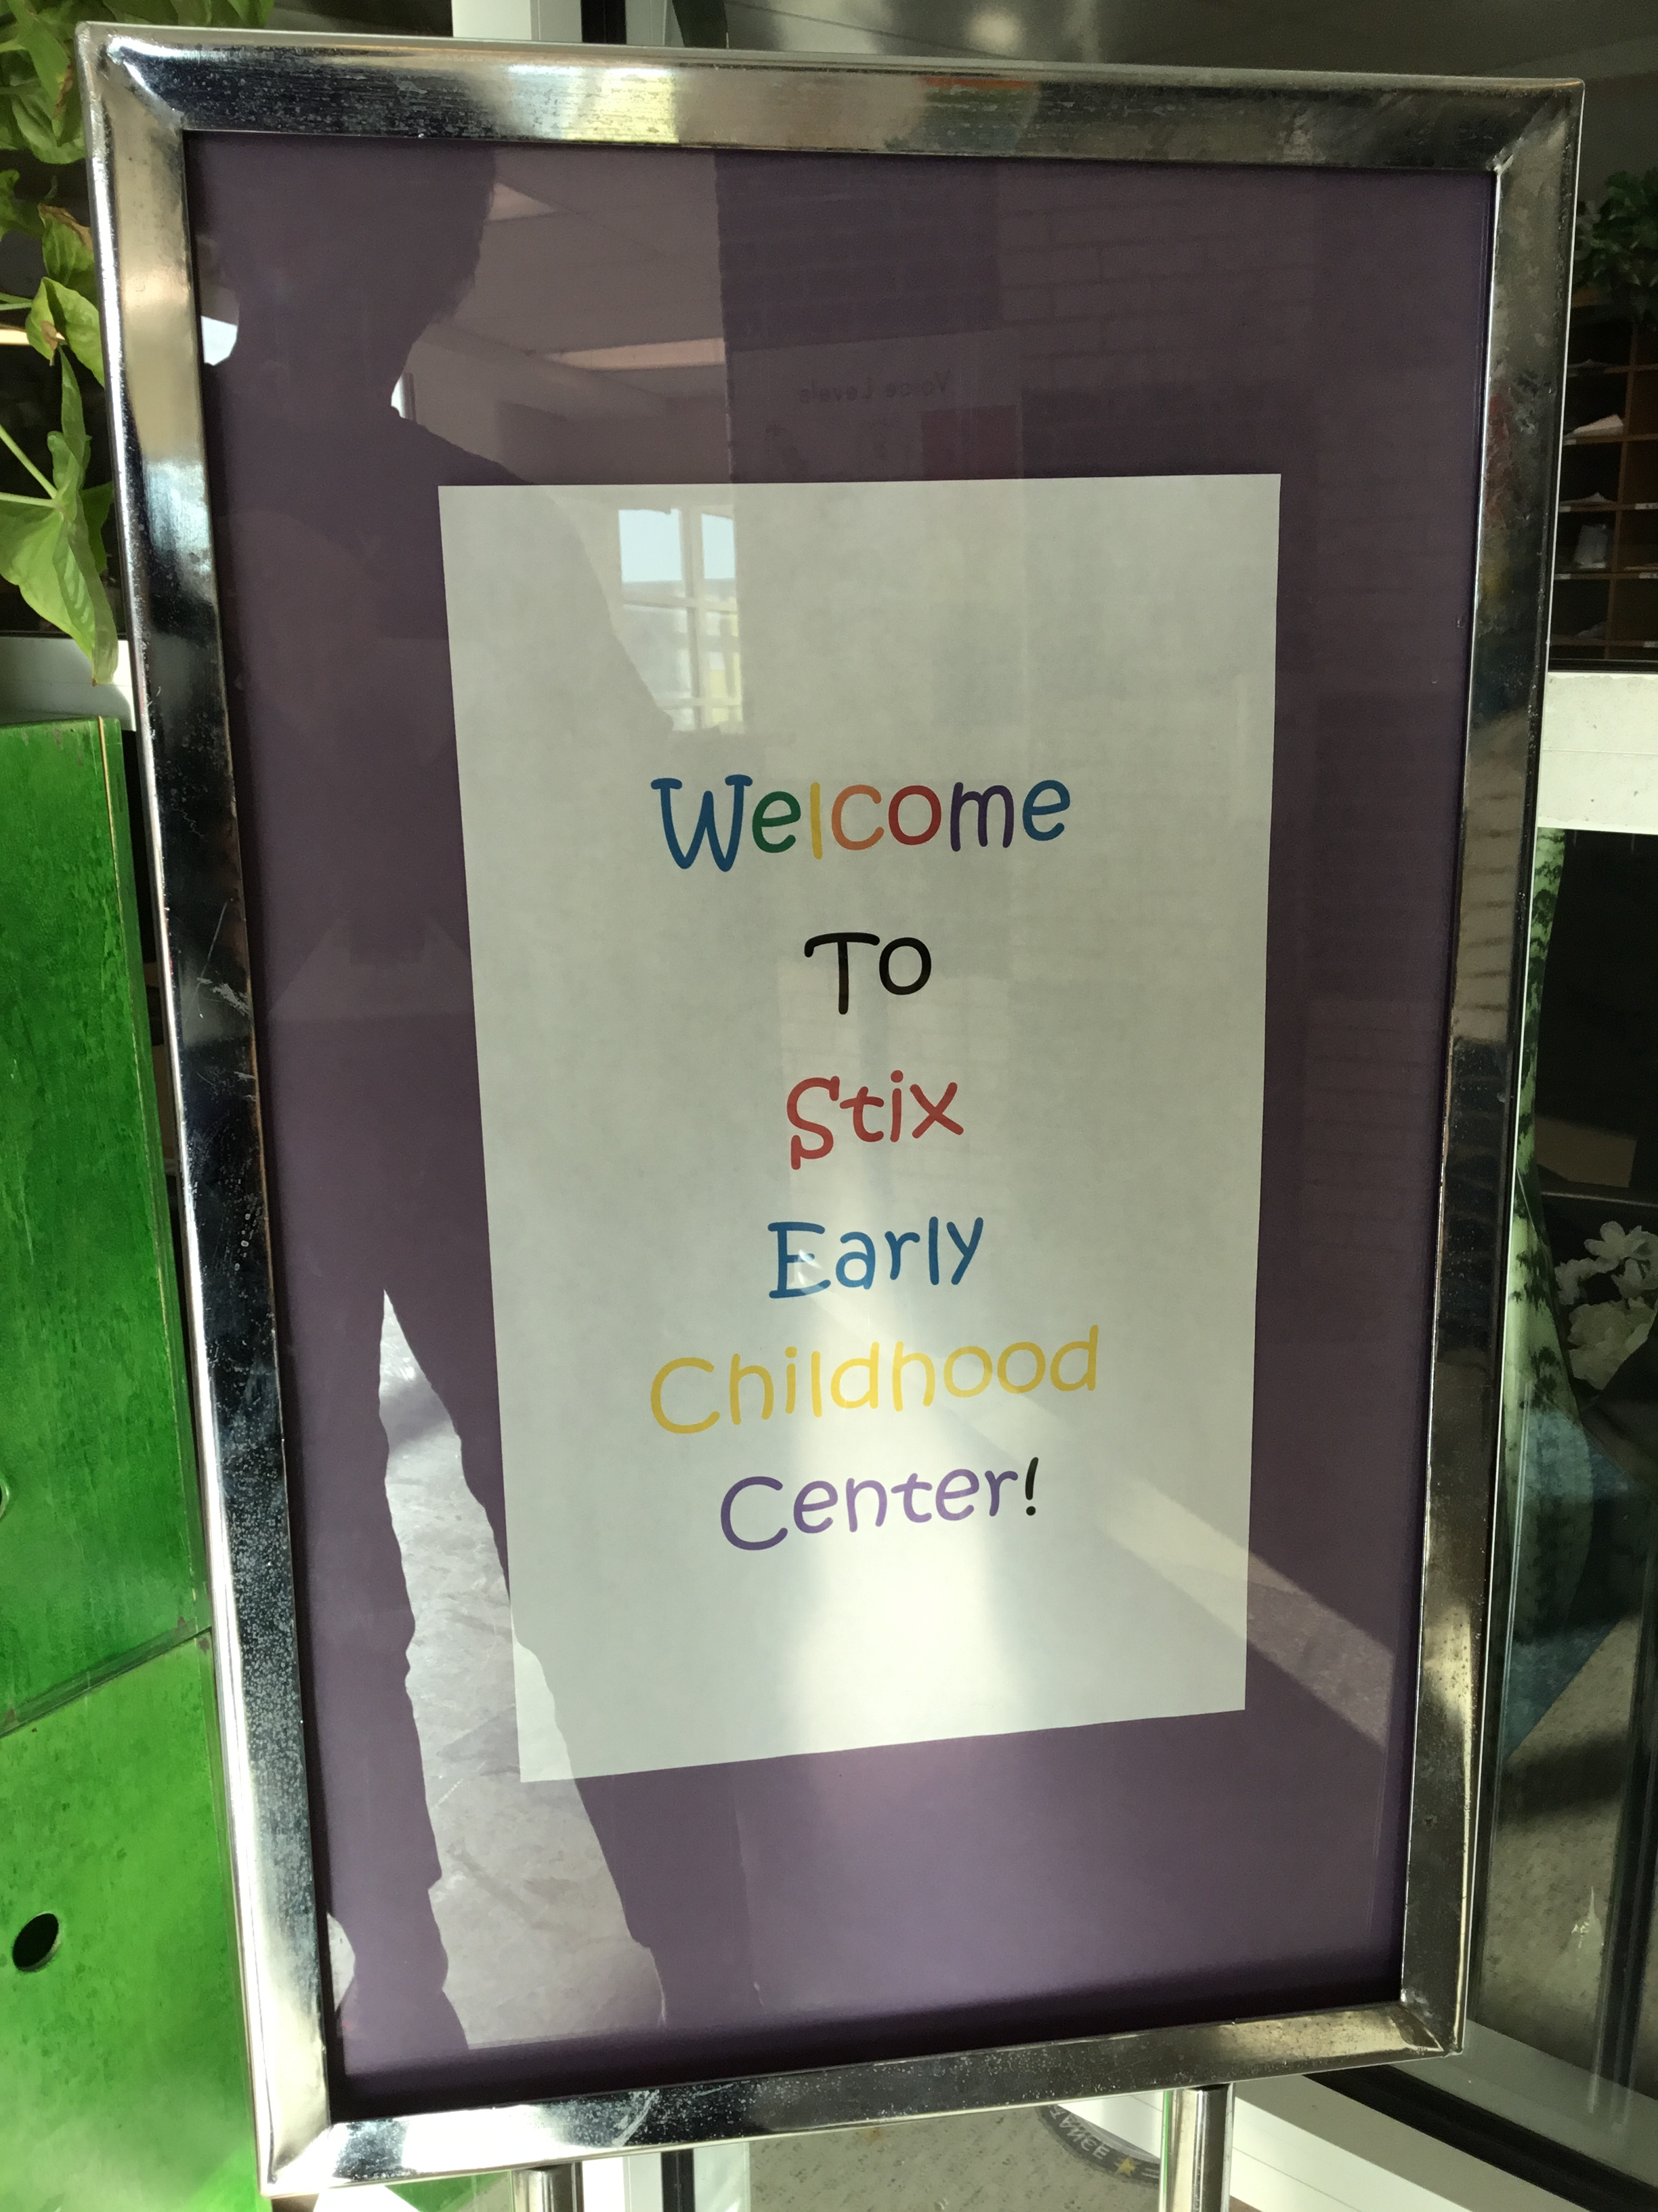
Welcome

Slide 3
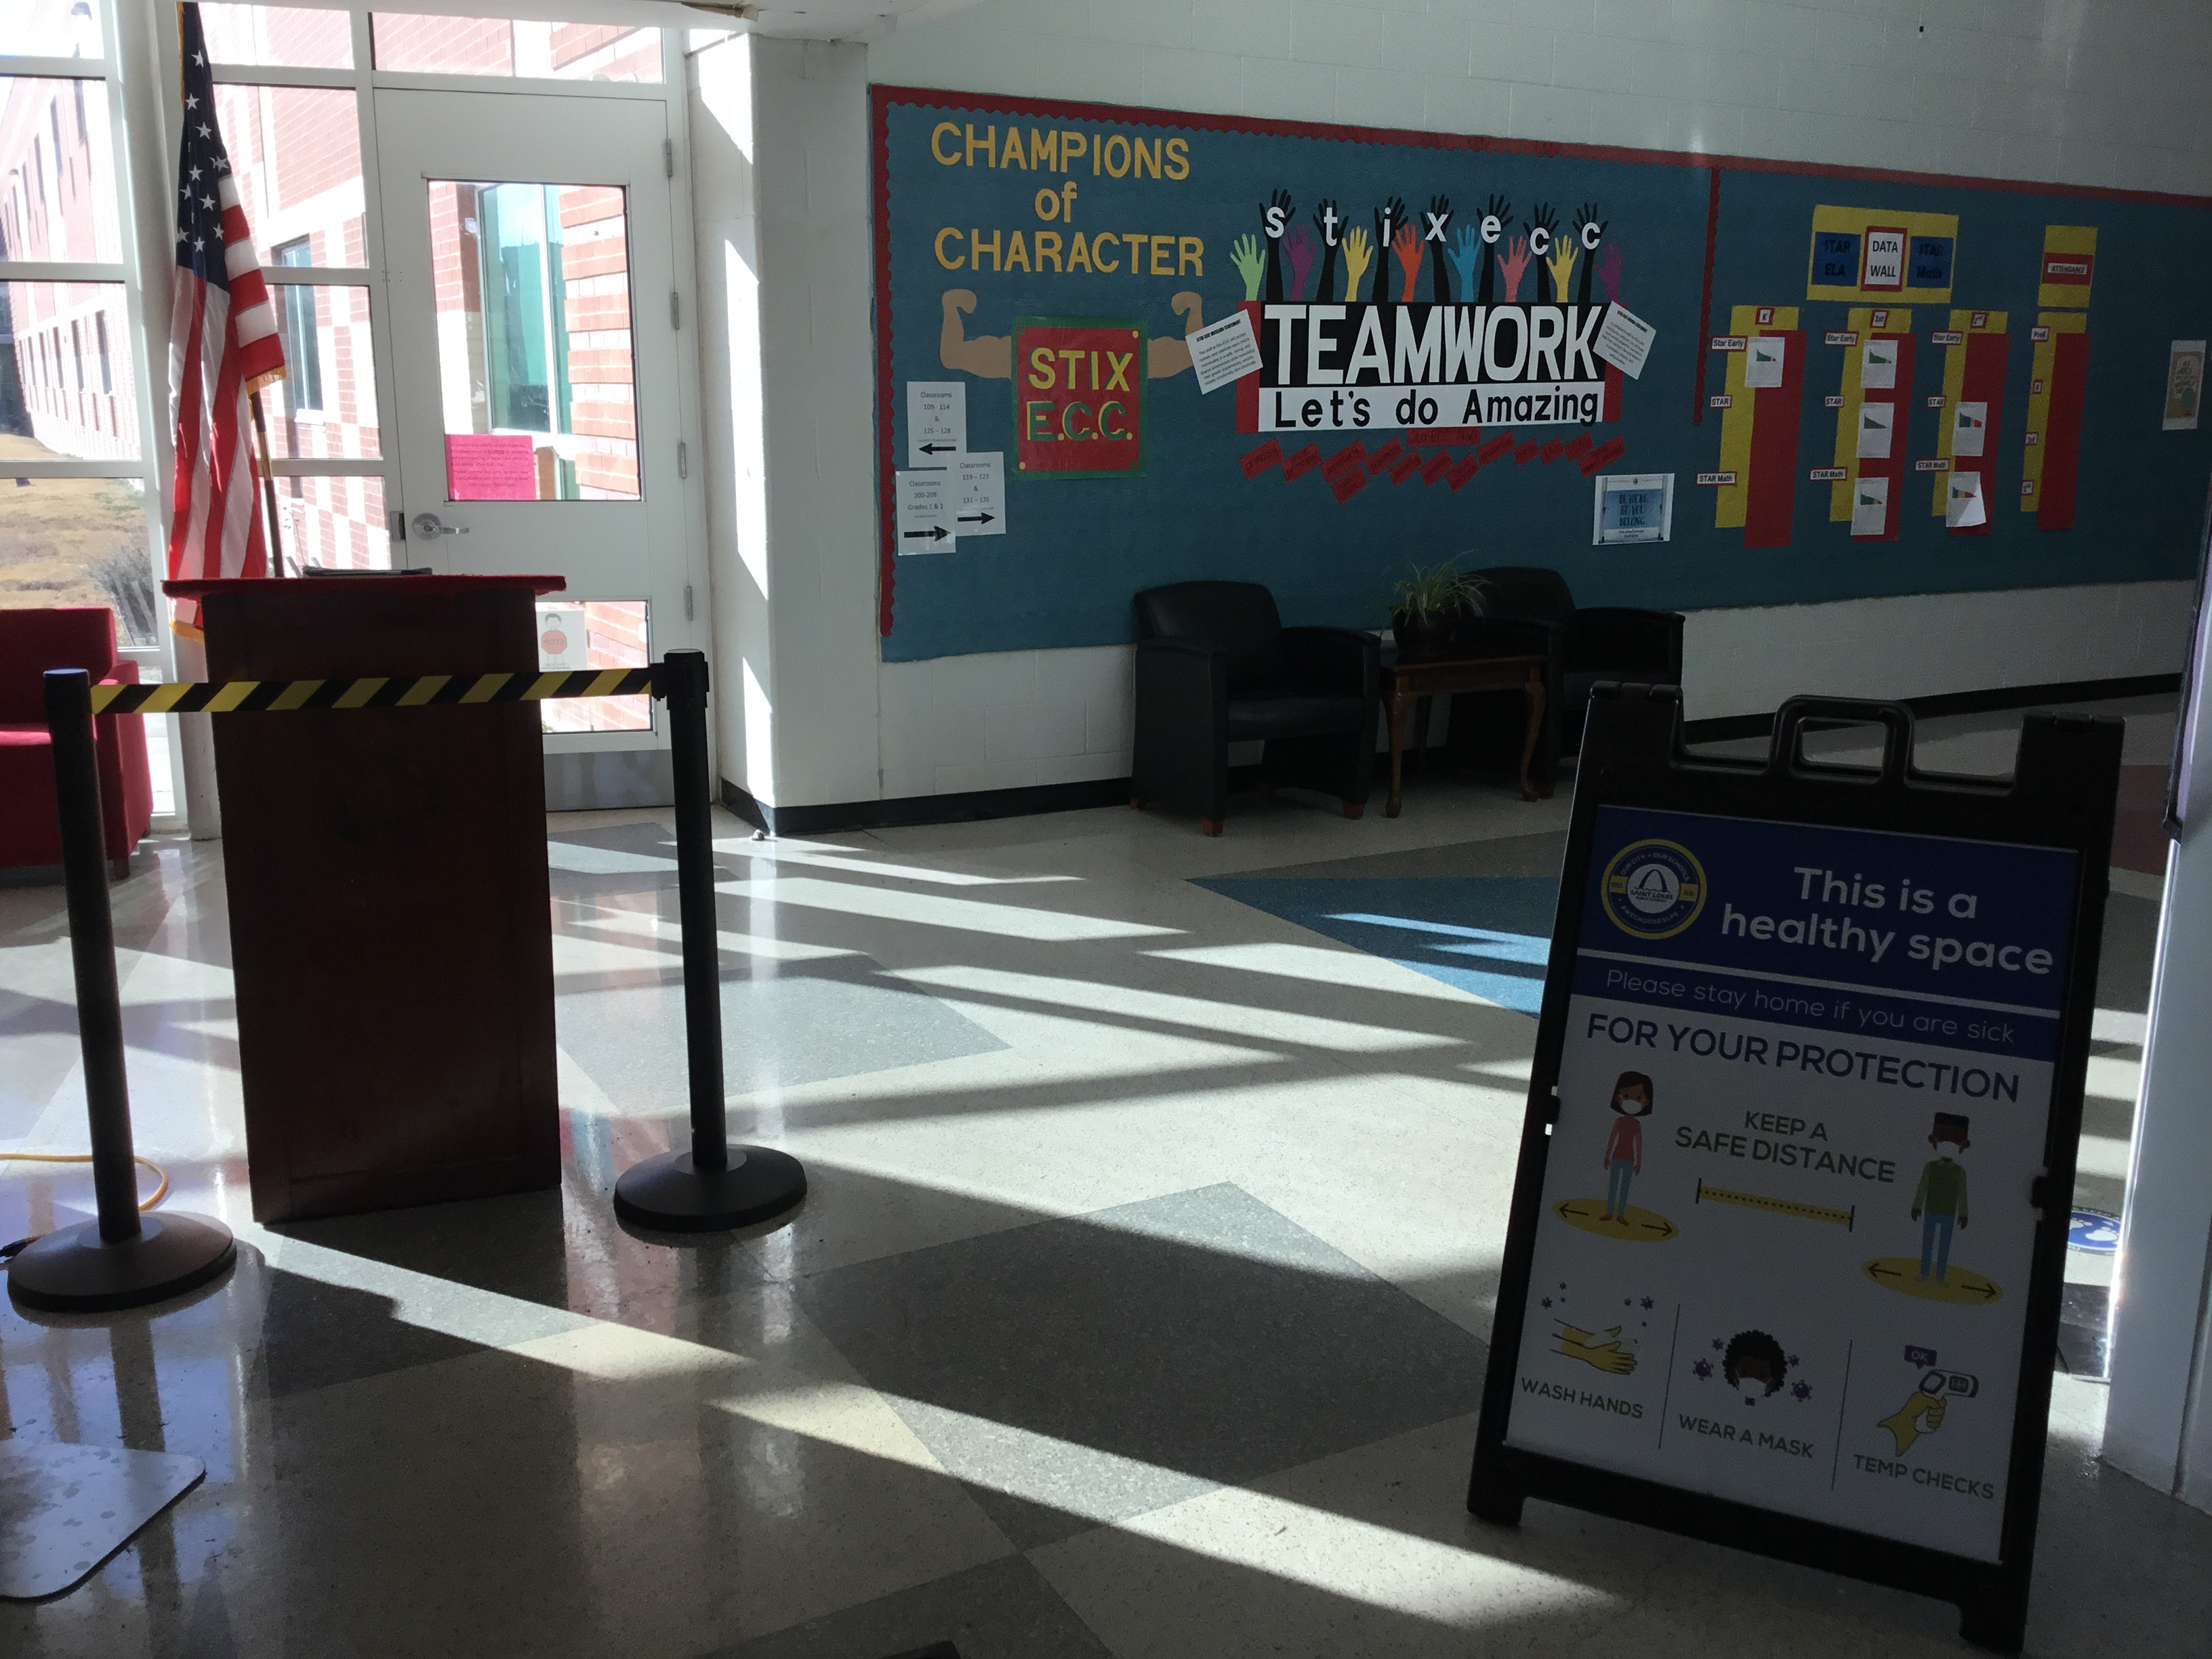
Covid-19 Safety Signage

Slide 4

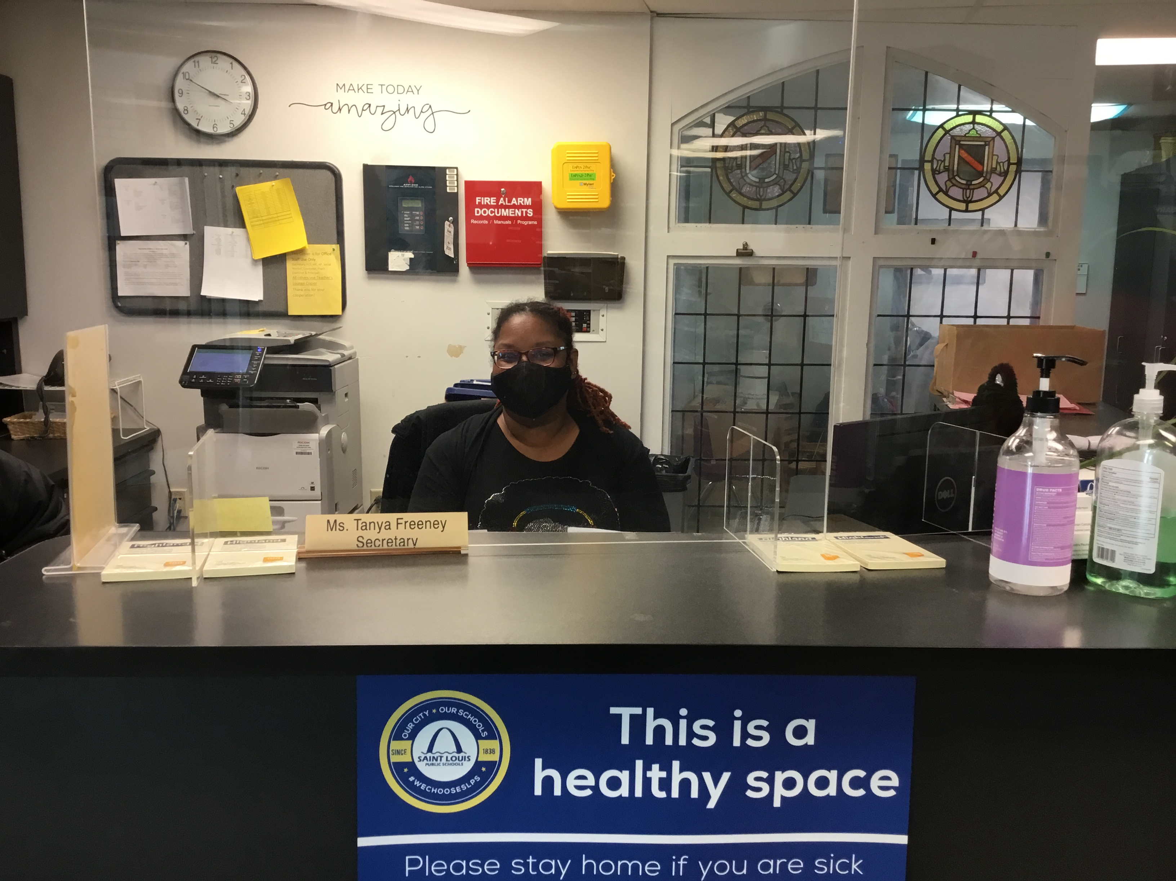
Ms. Freeney~ Secretary

Slide 5
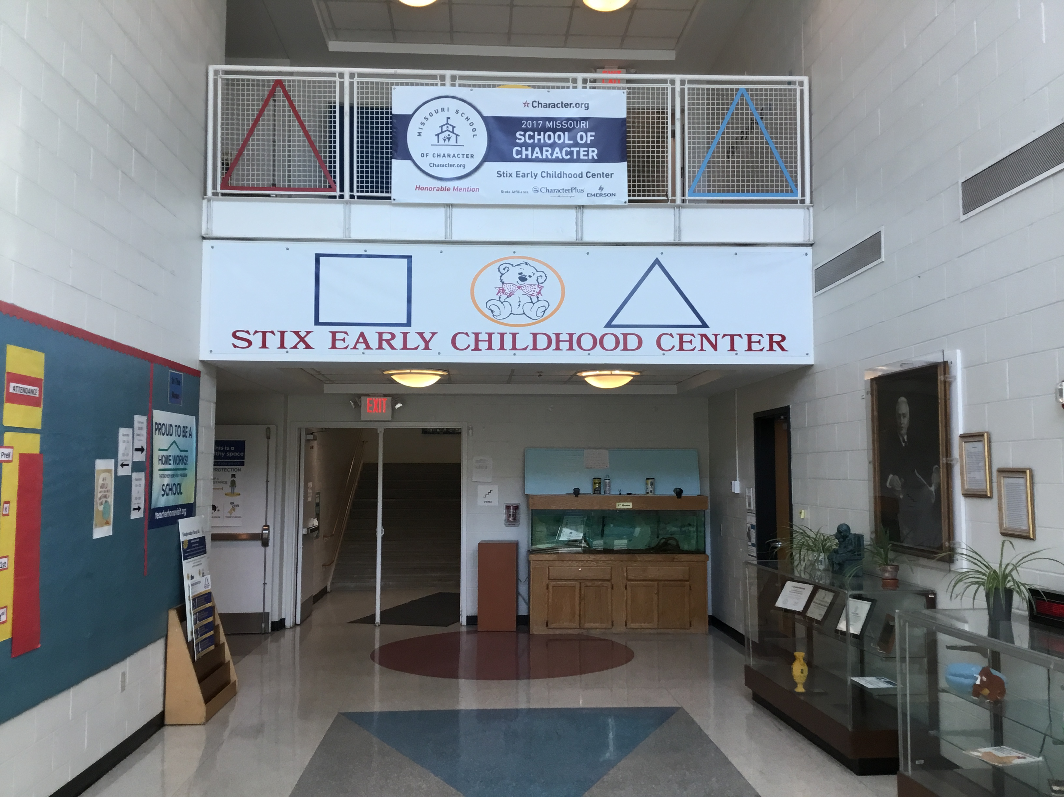
Entrance Hallway

Slide 6
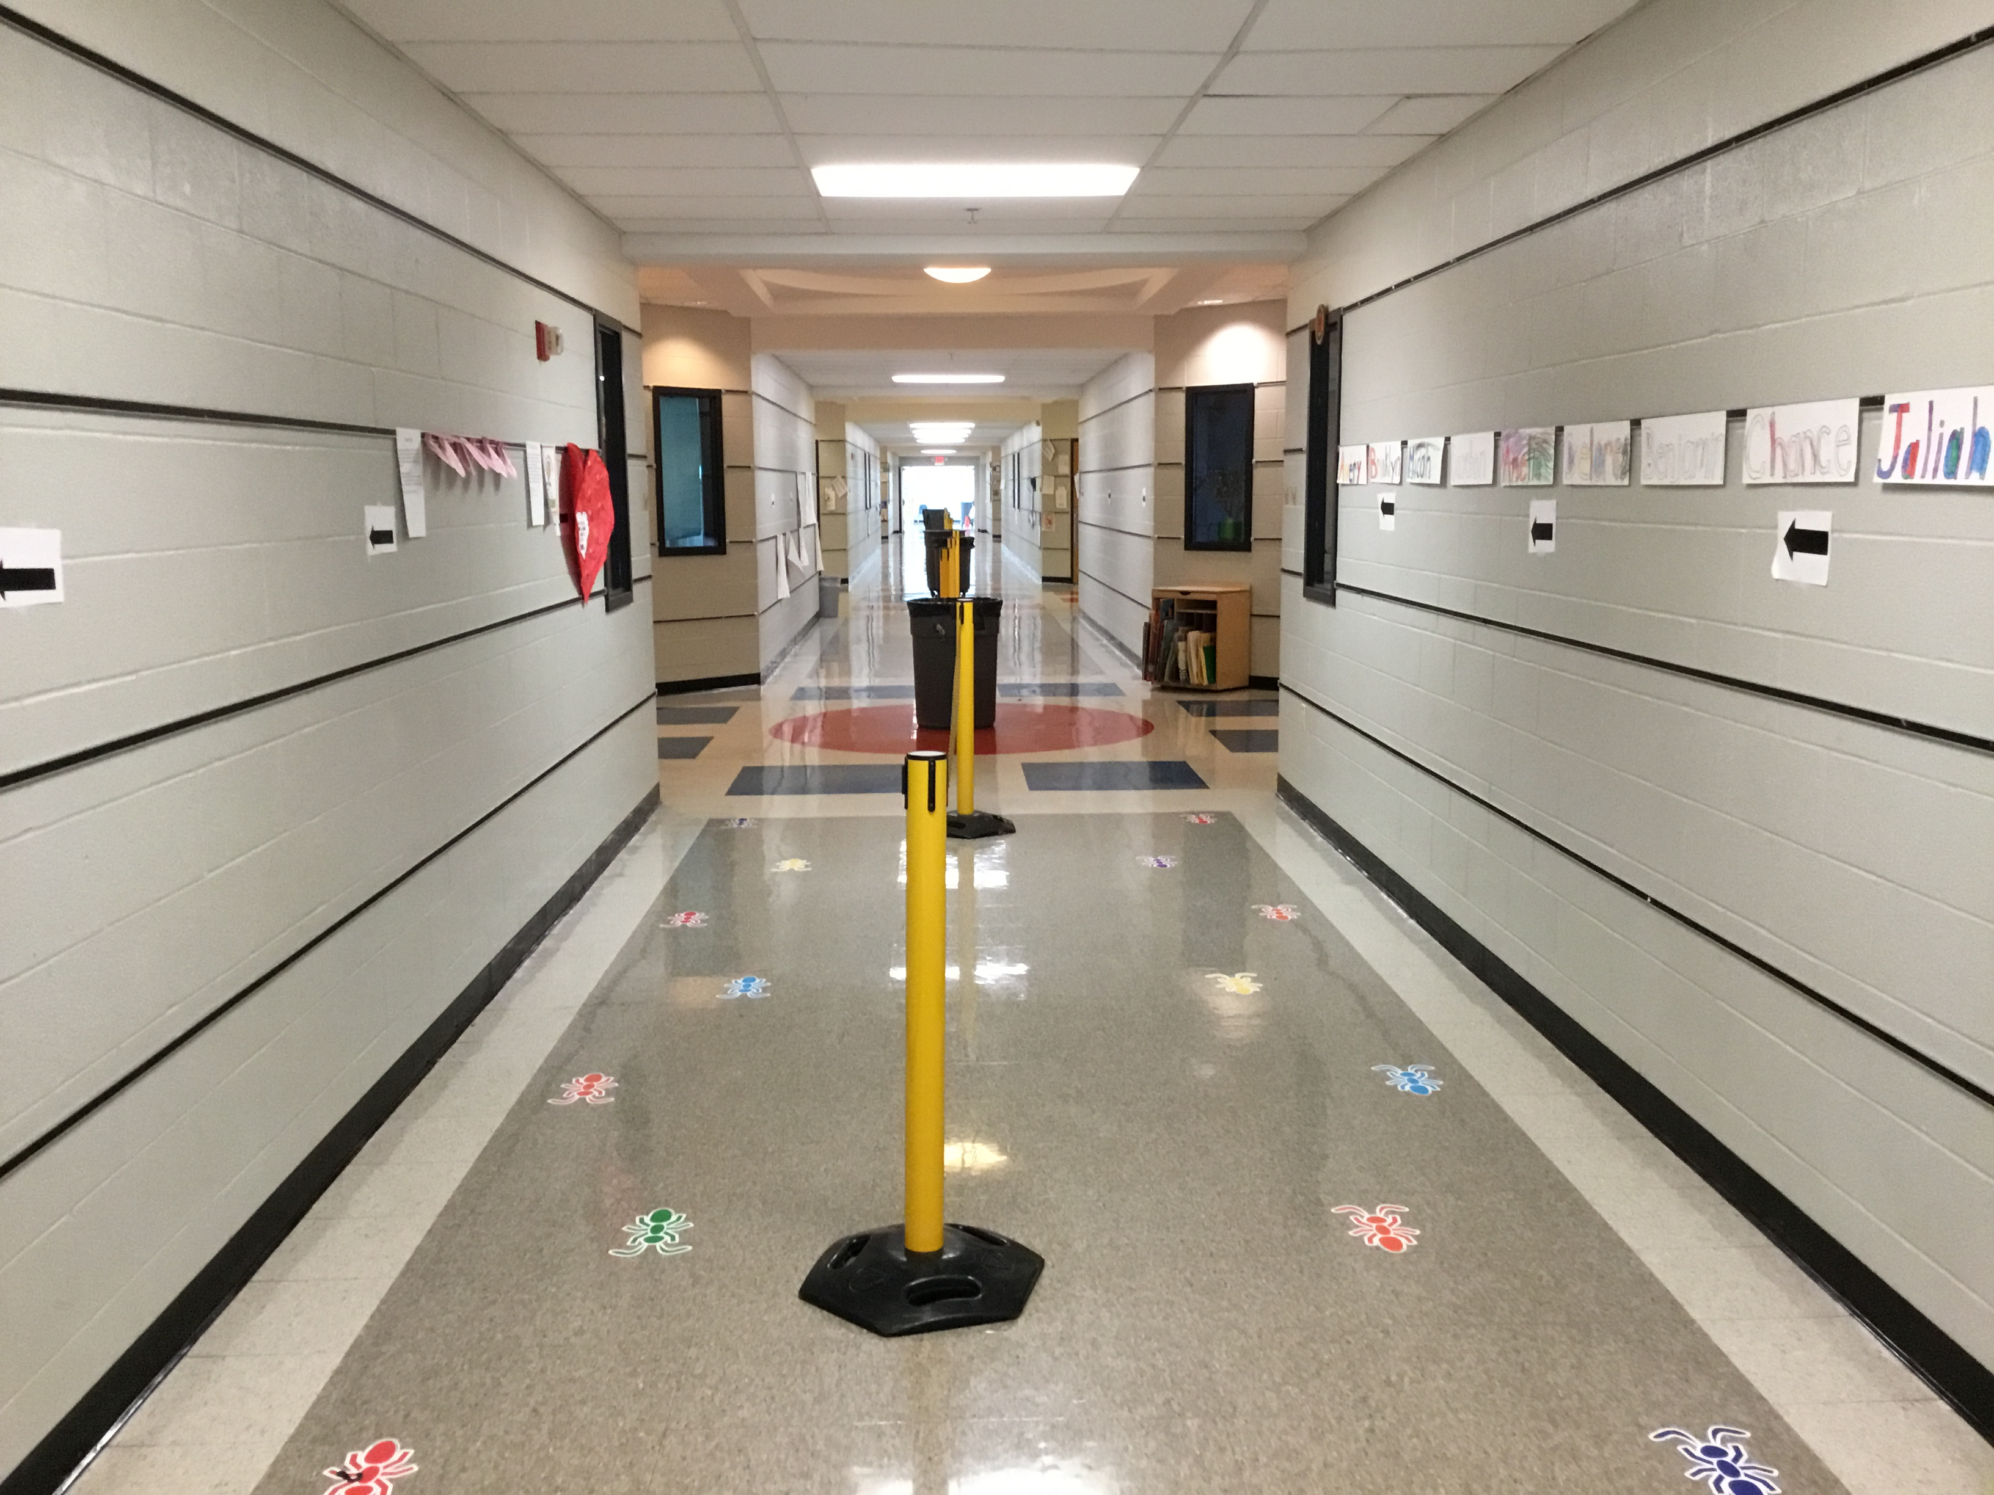
Pre-School Hallway

Slide 7
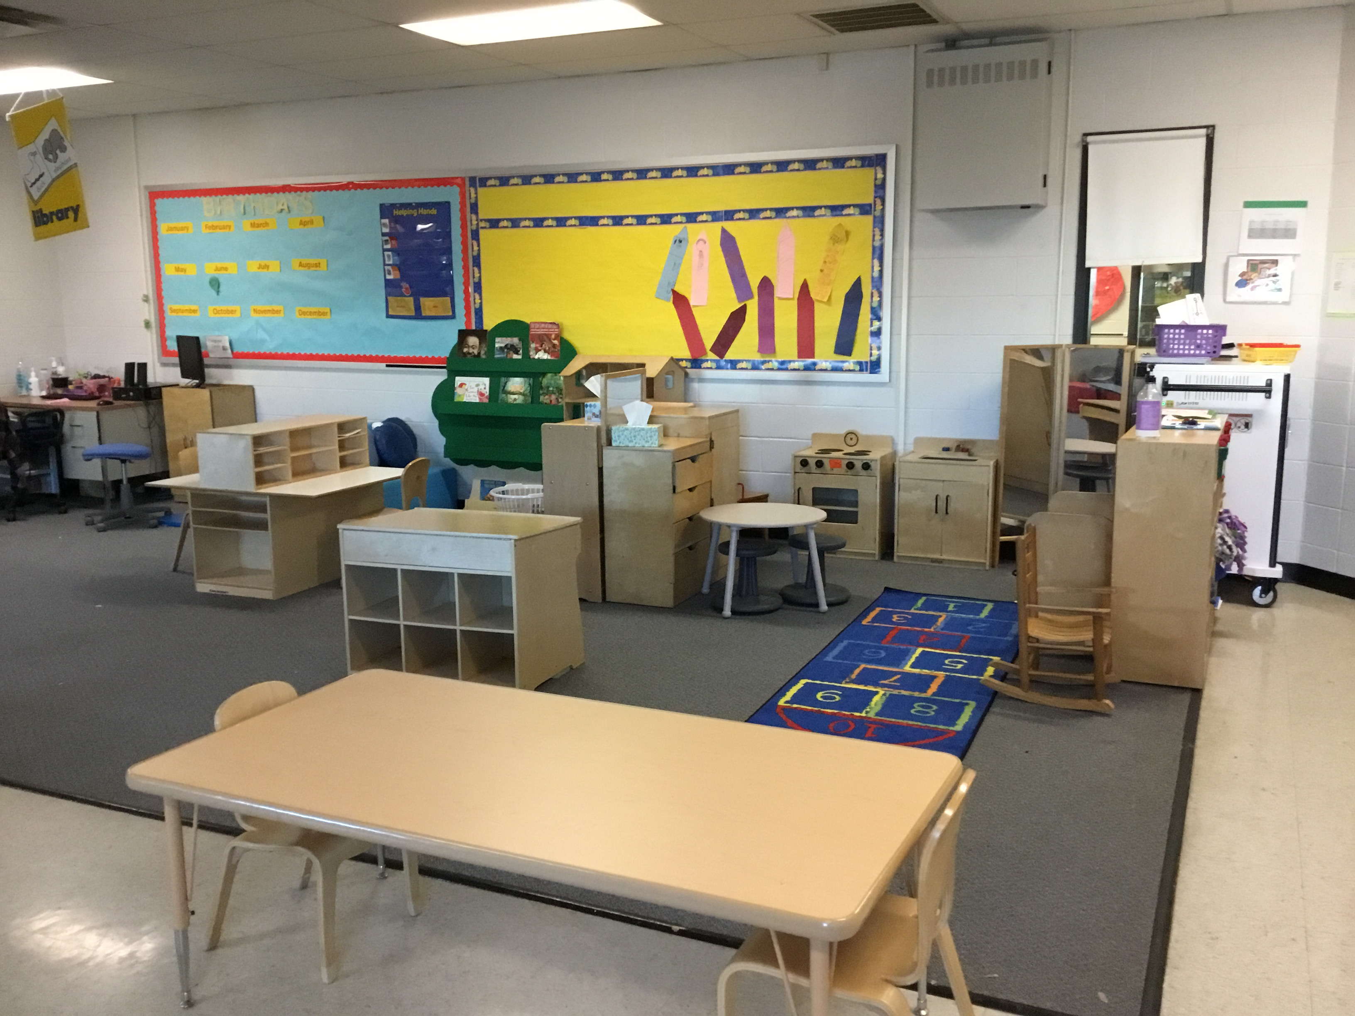
Pre-School Classroom

Slide 8
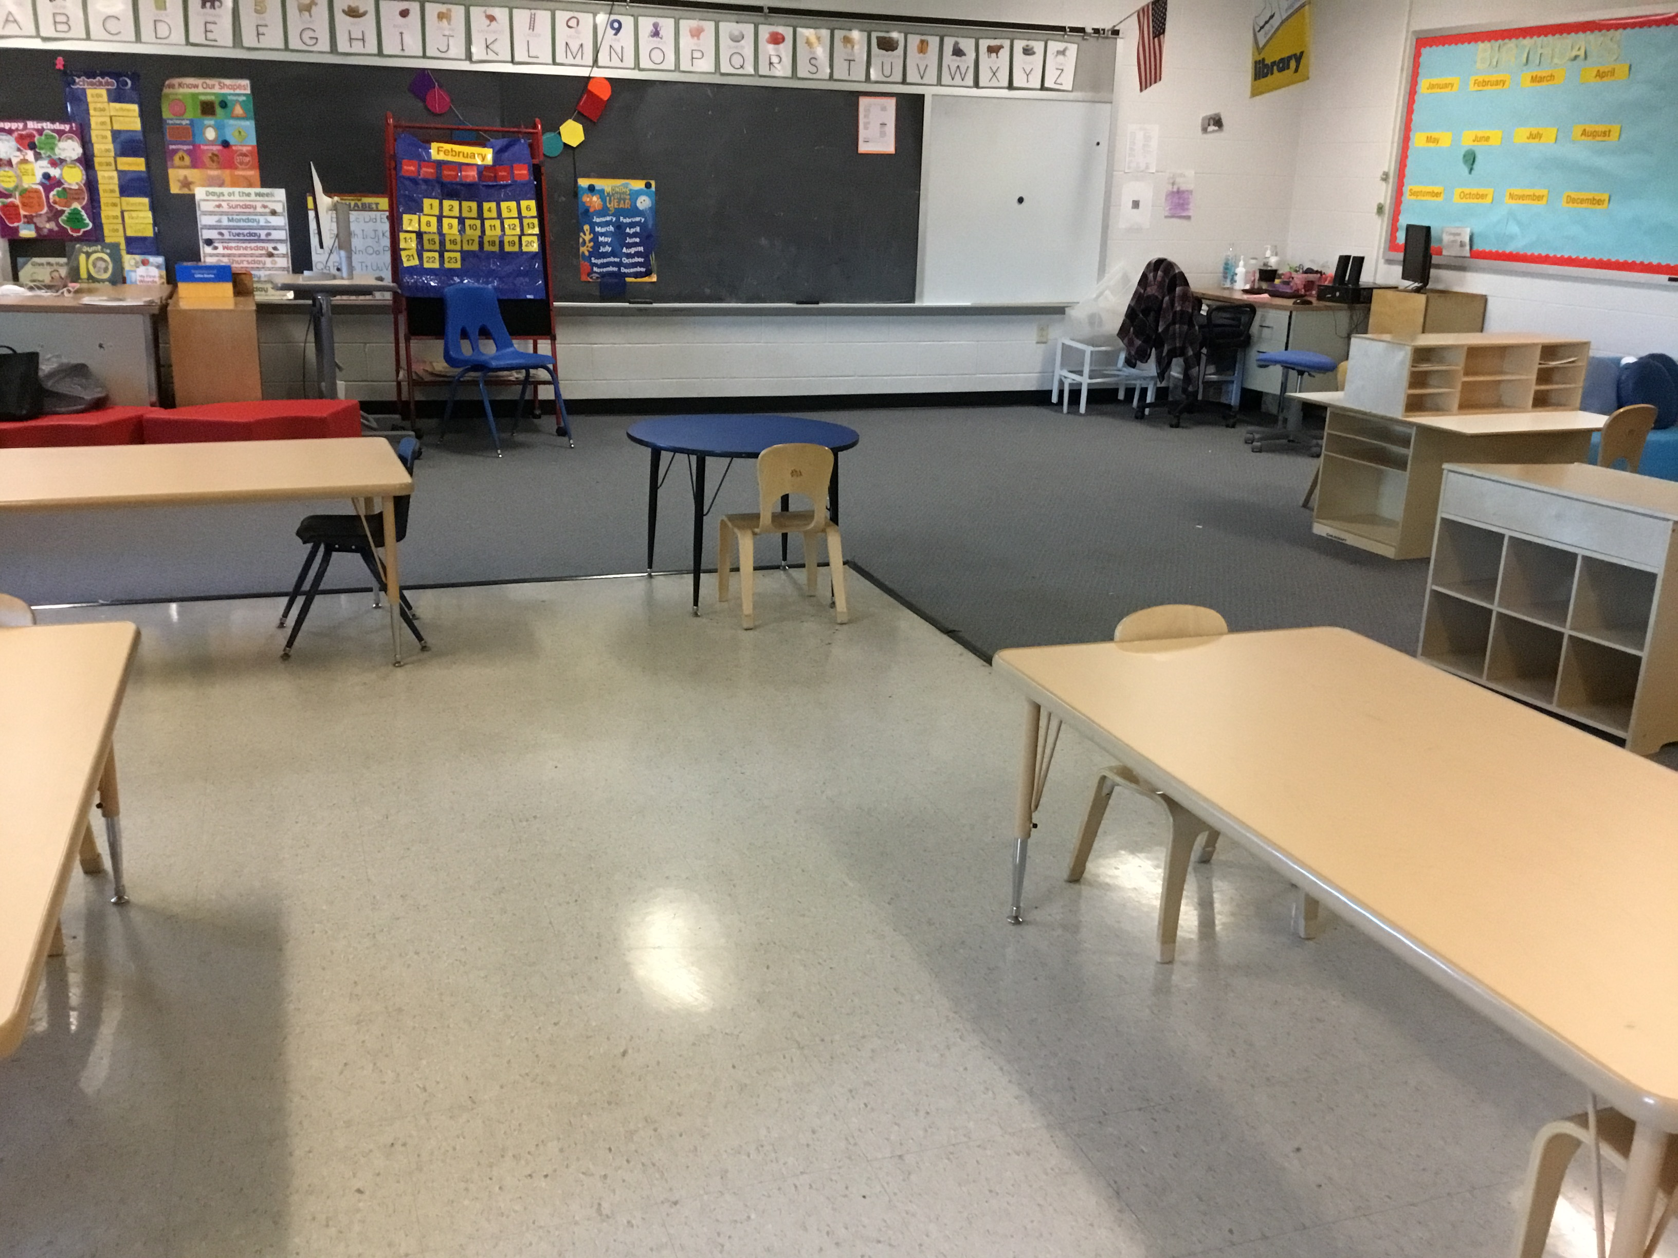
Pre-School Classroom

Slide 9
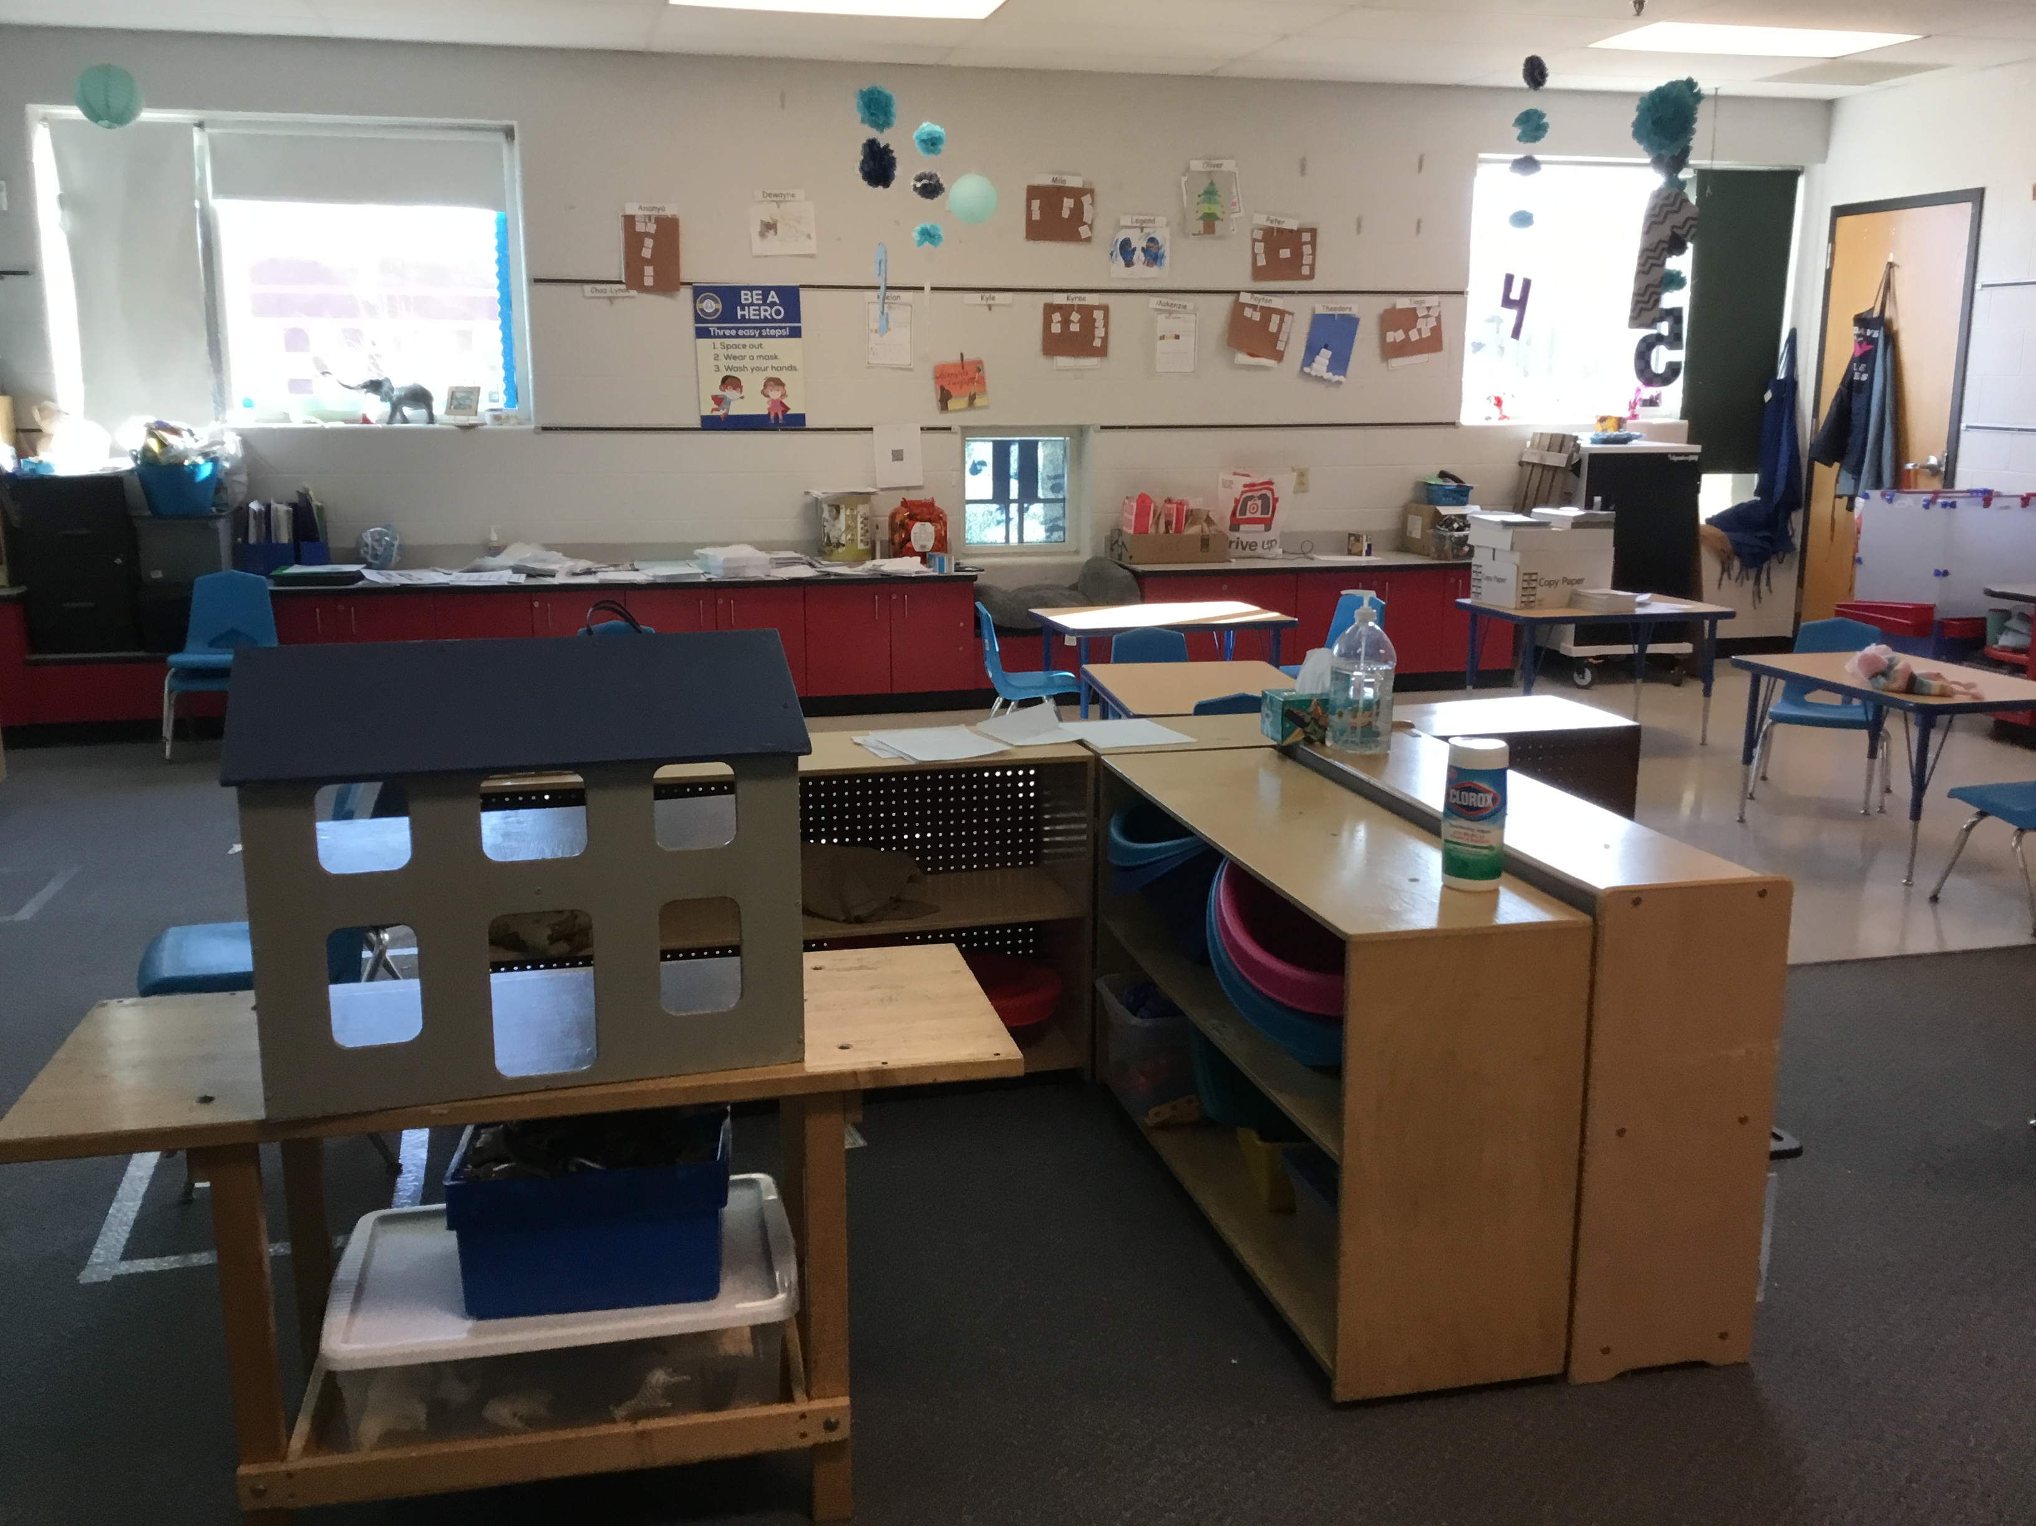
Pre-School Classroom

Slide 10
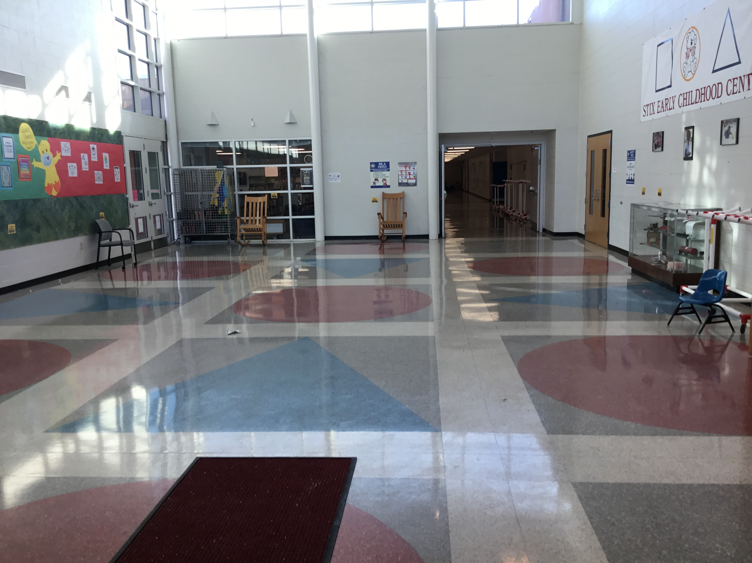
Bus Loading / Unloading area (Atrium)

Slide 11
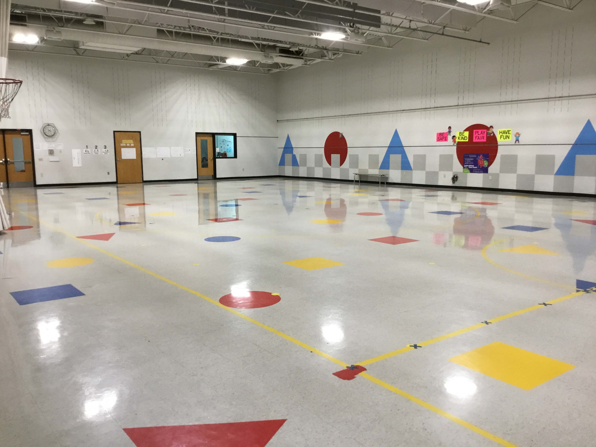
Gymnasium

Slide 12
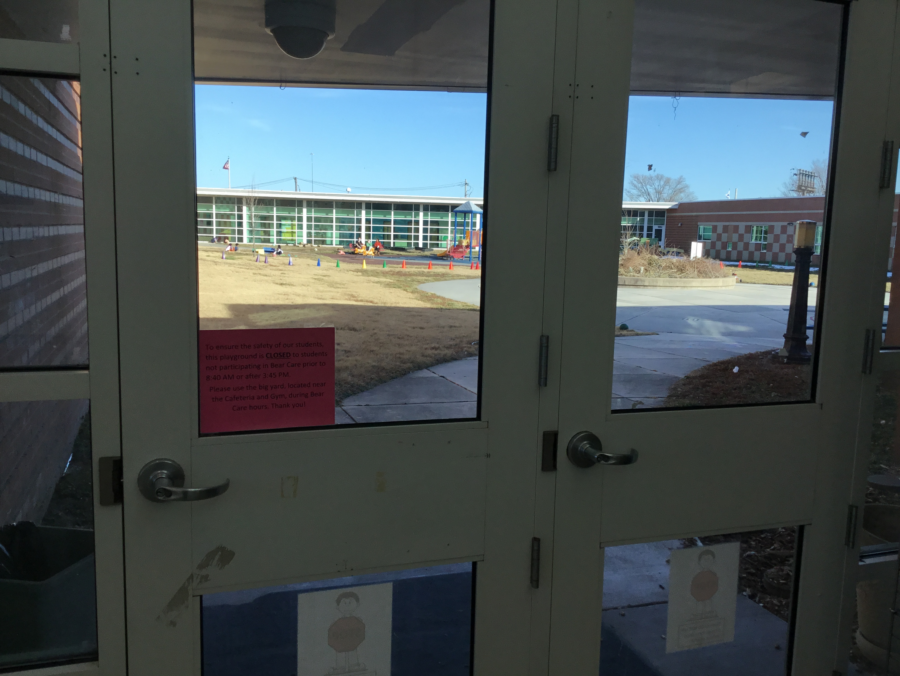
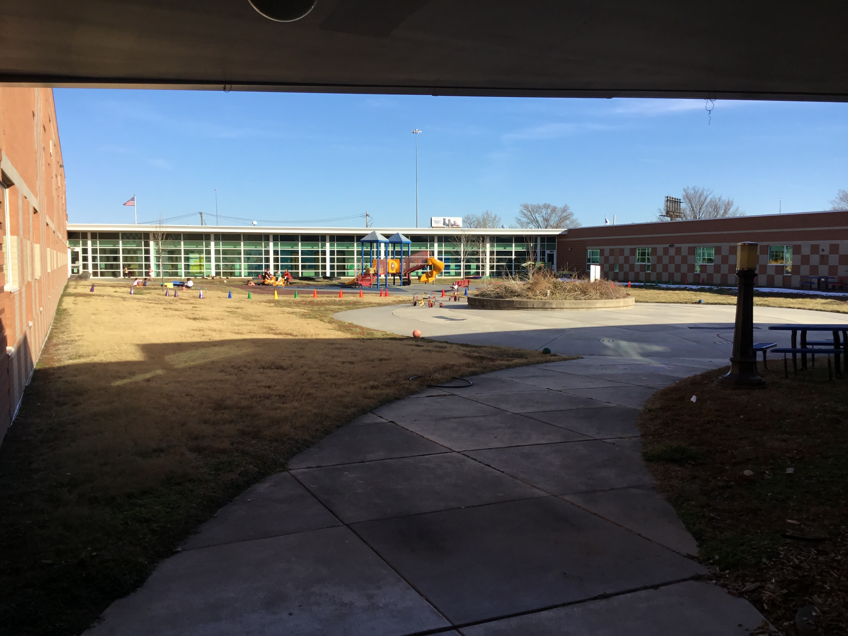
Atrium View
Front entrance view
Pre-School Playground

Slide 13
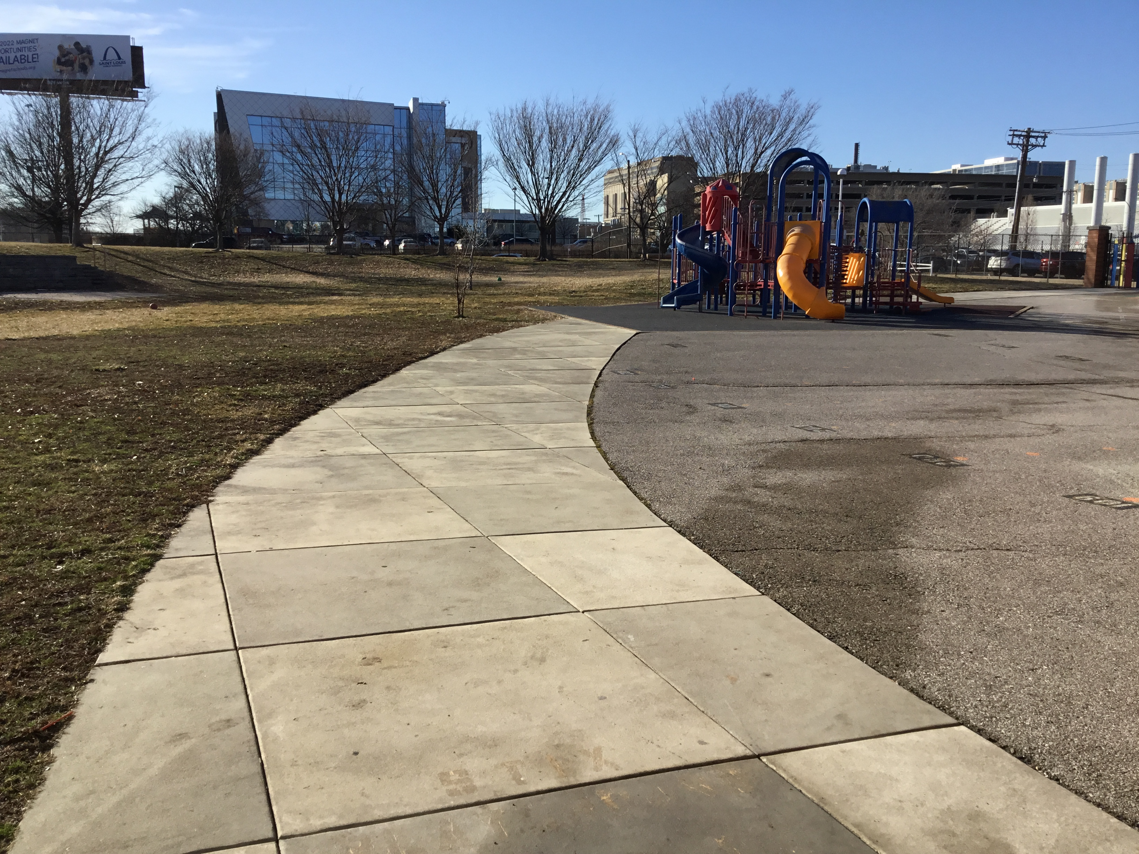
Big Playground~ Kindergarten -2nd grade

Slide 14
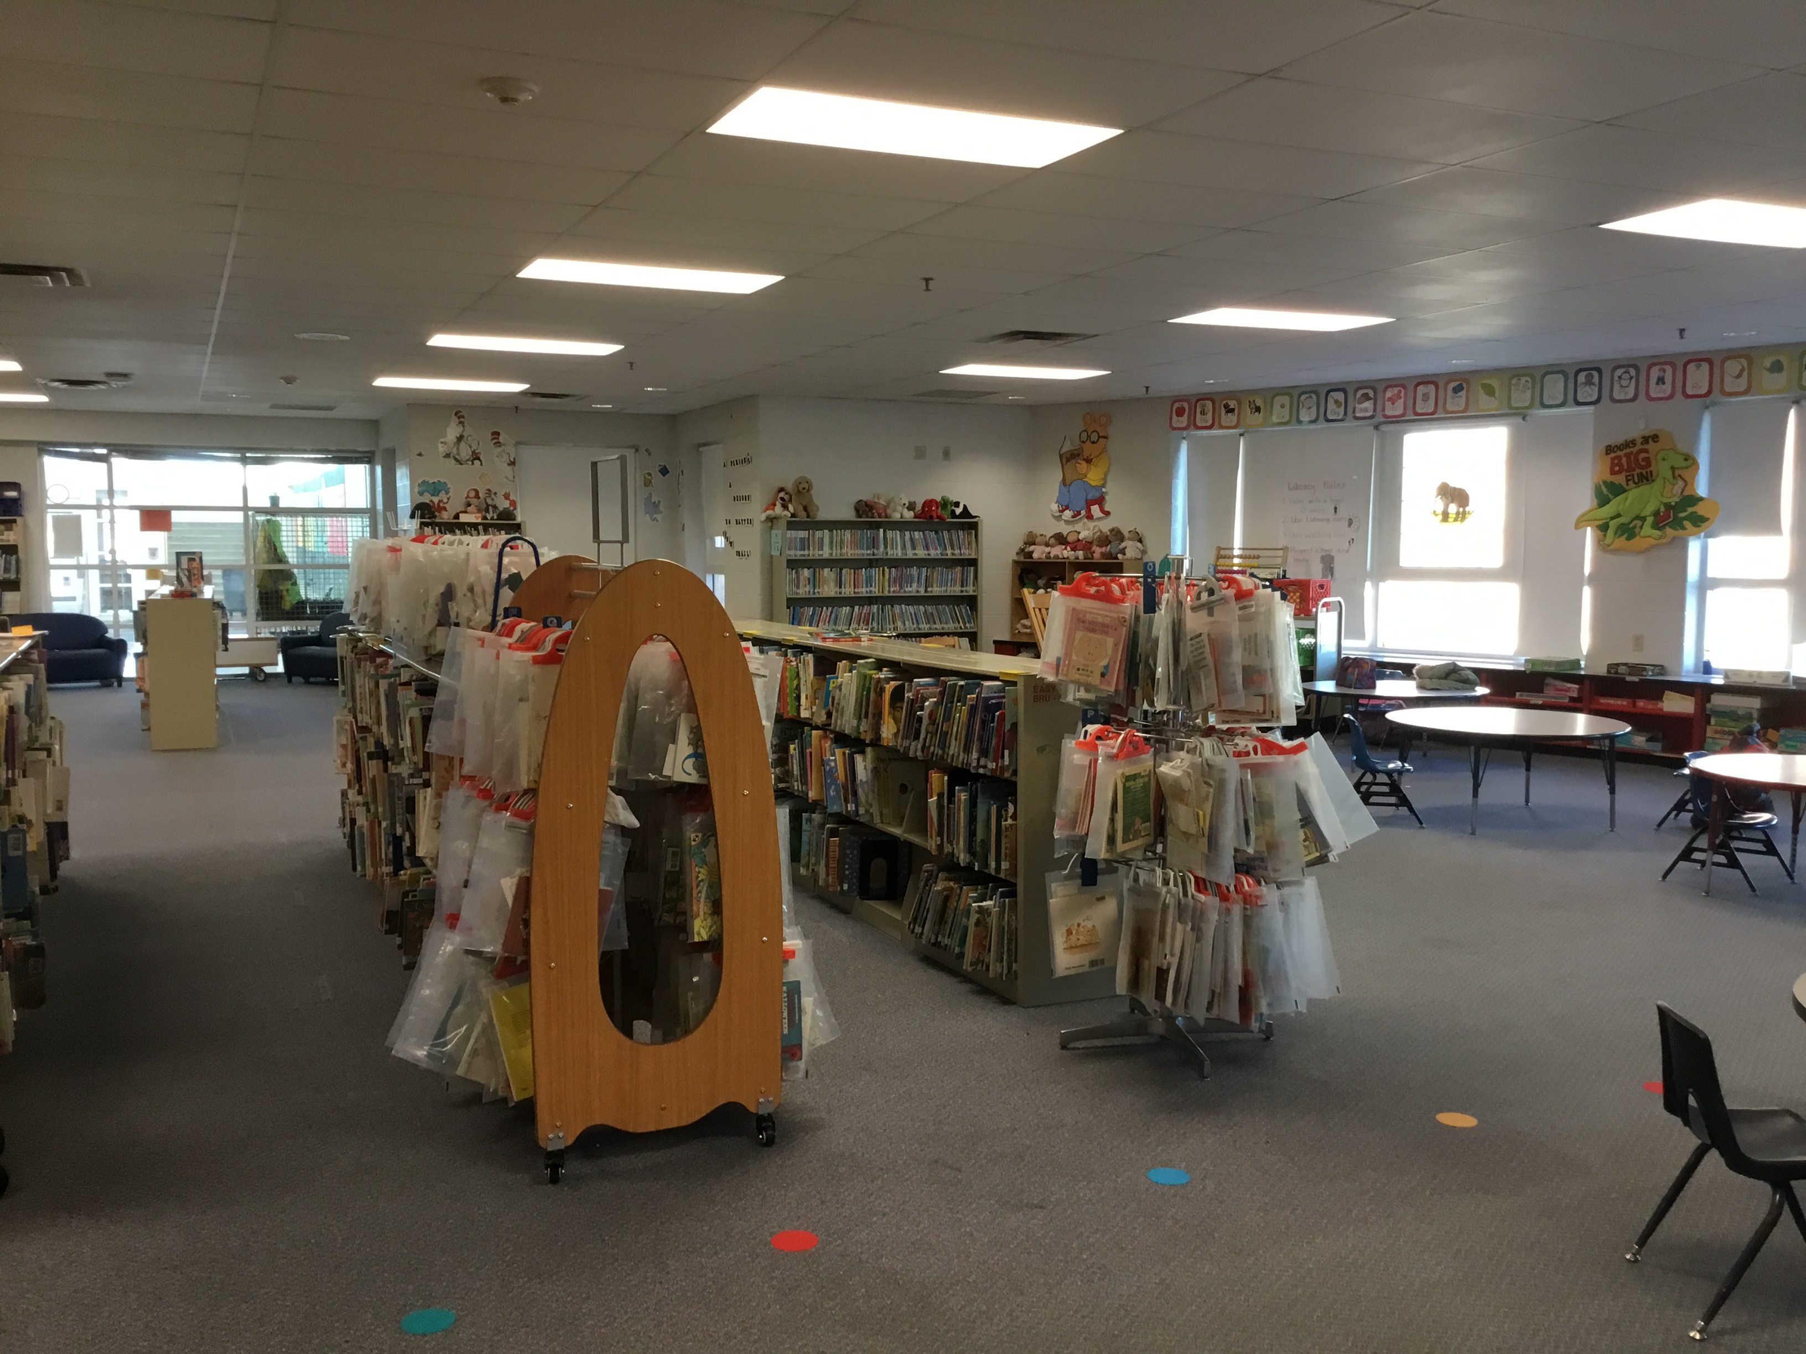
Library

Slide 15
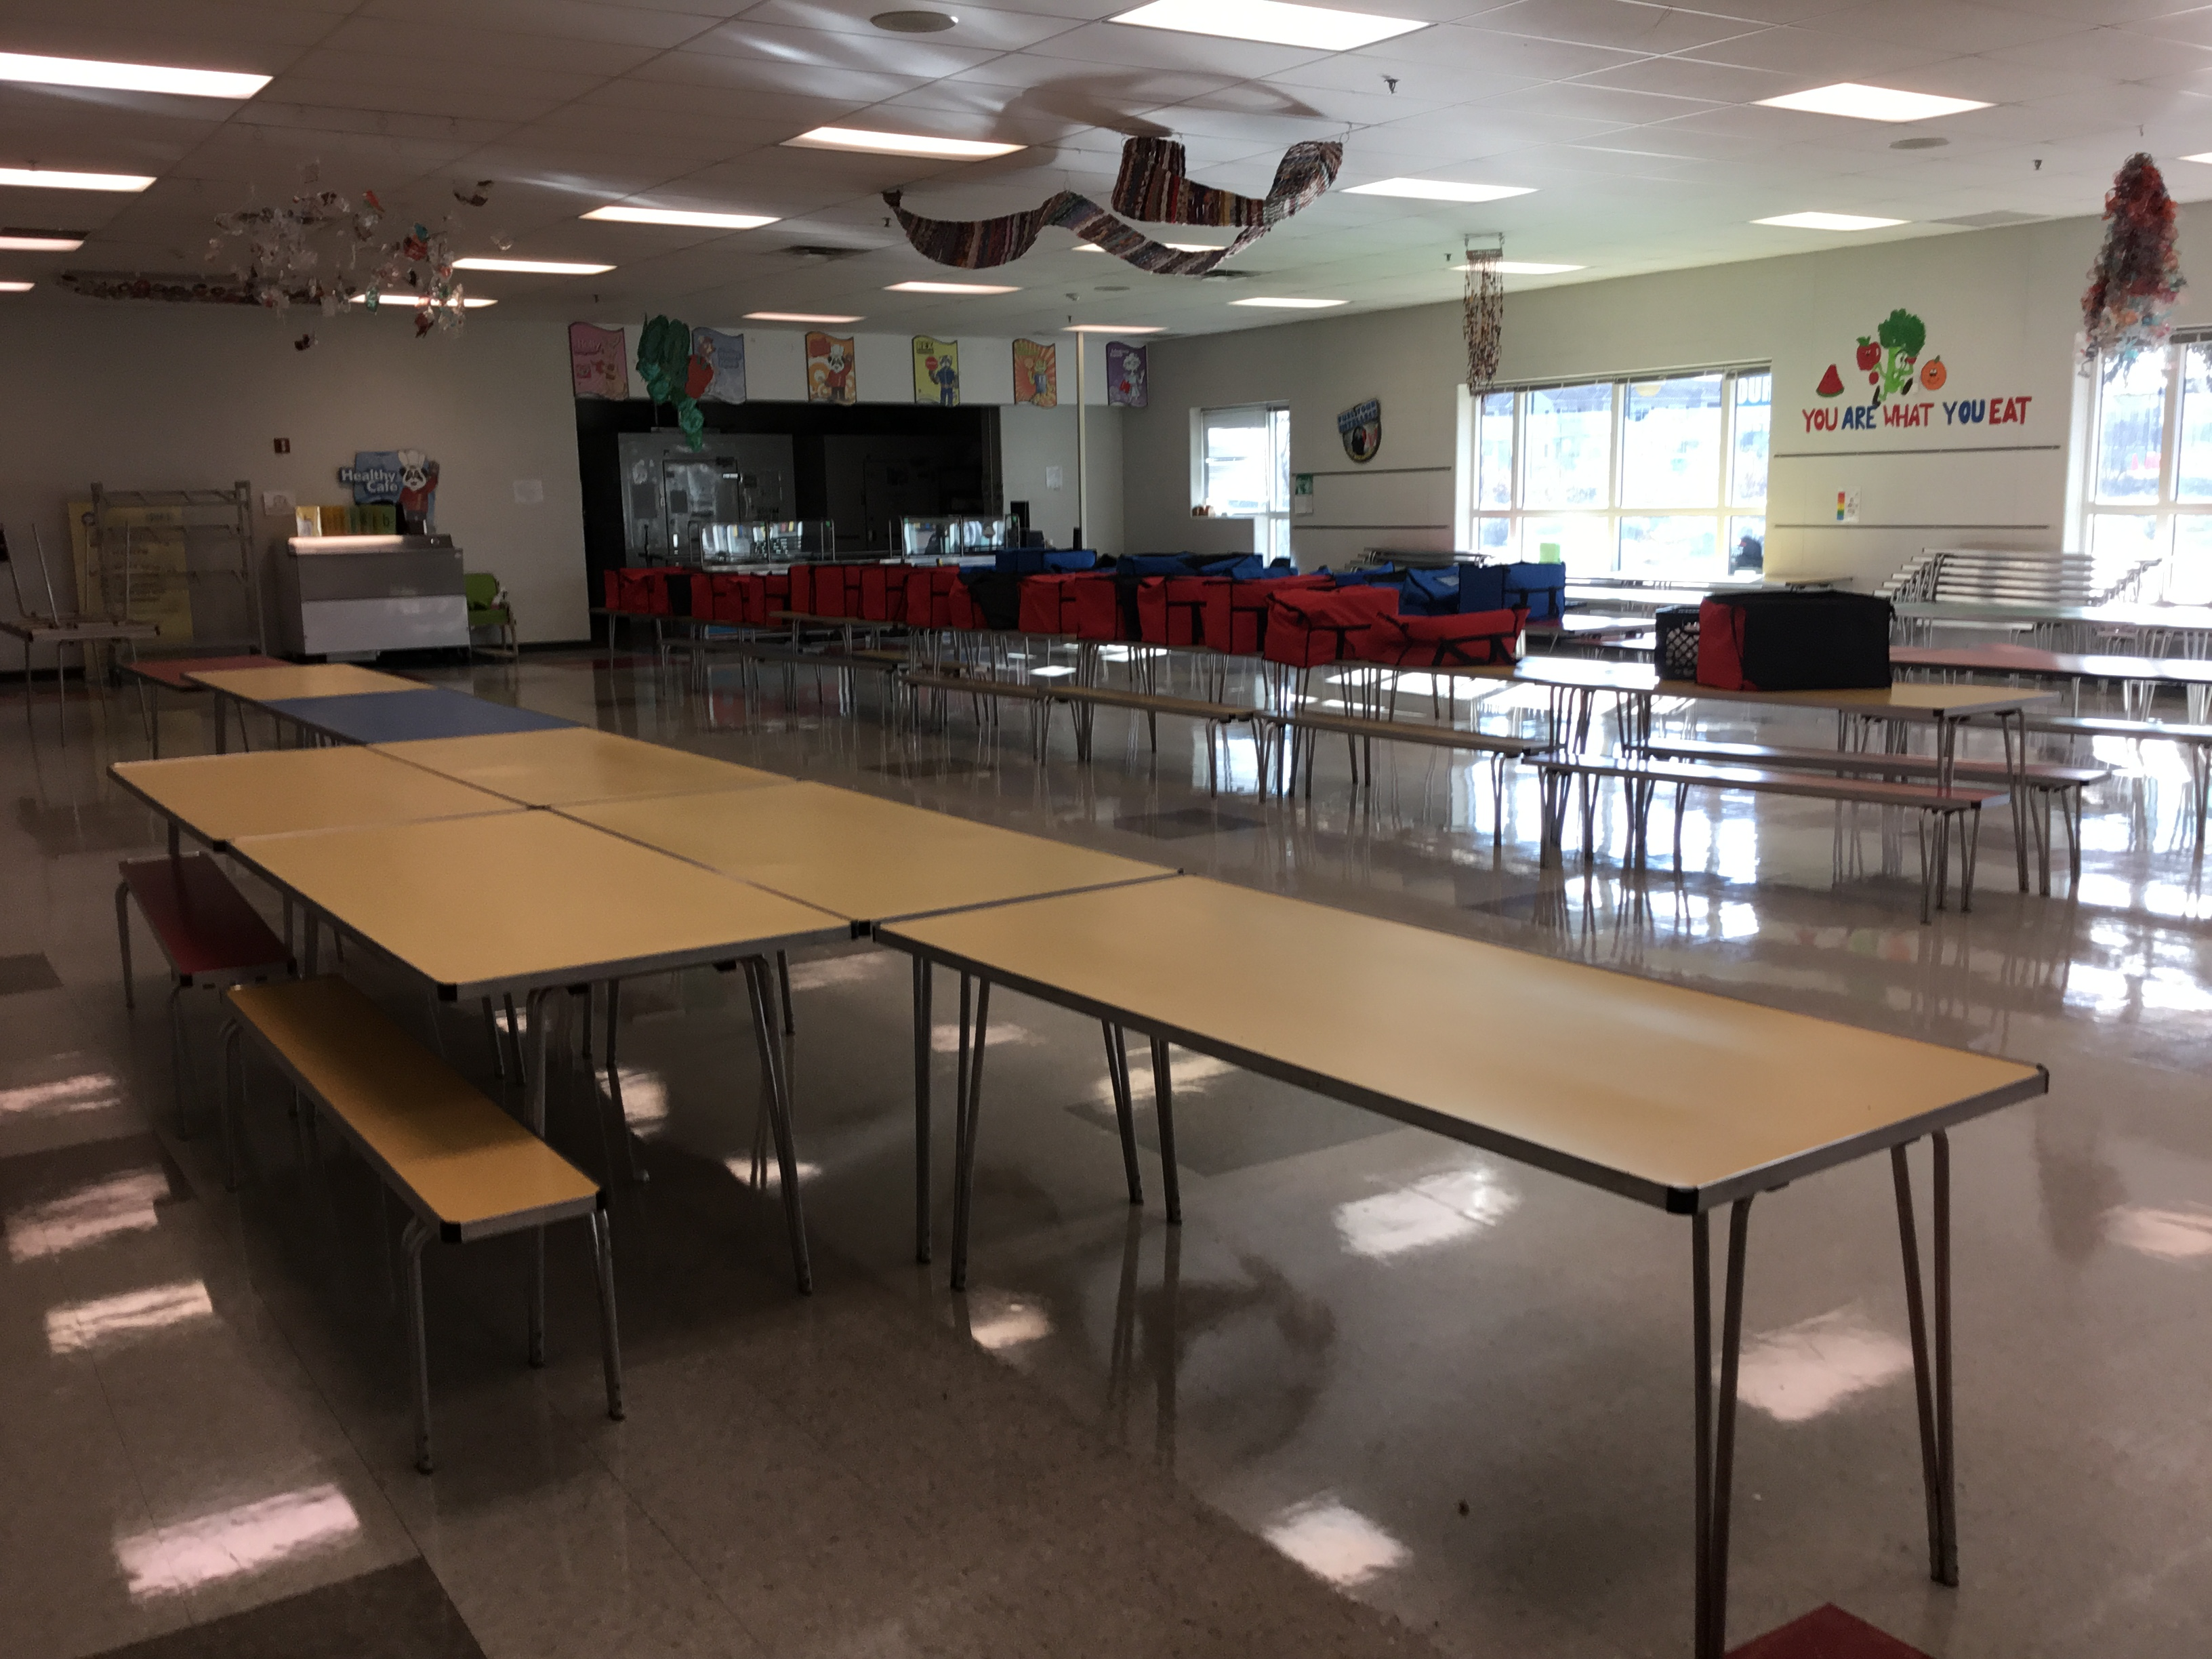
Cafeteria

Slide 16
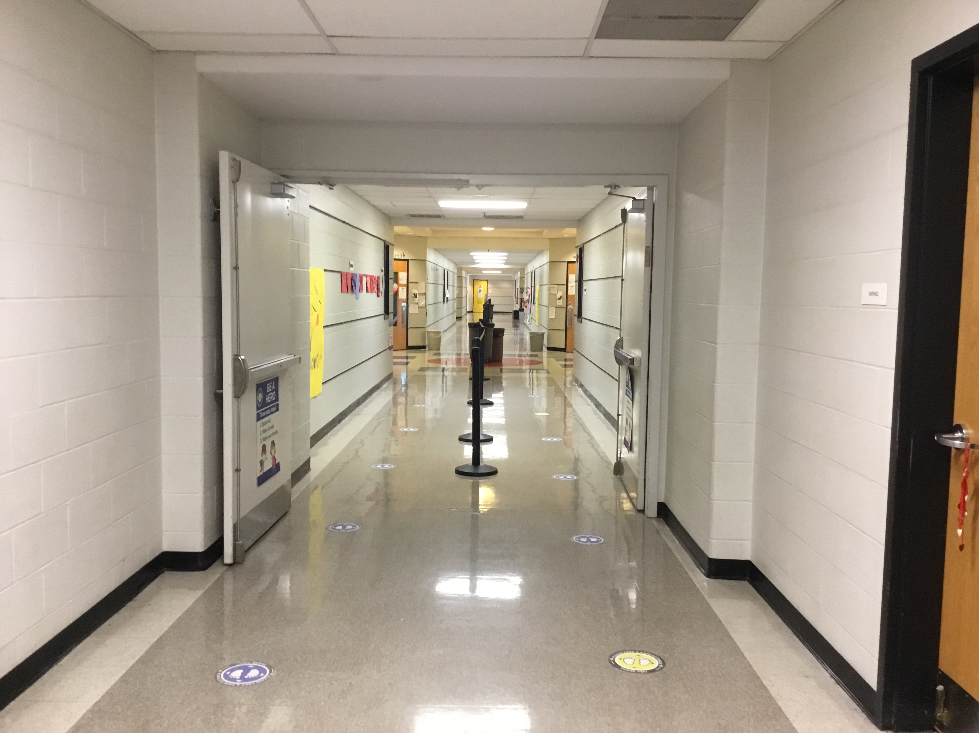
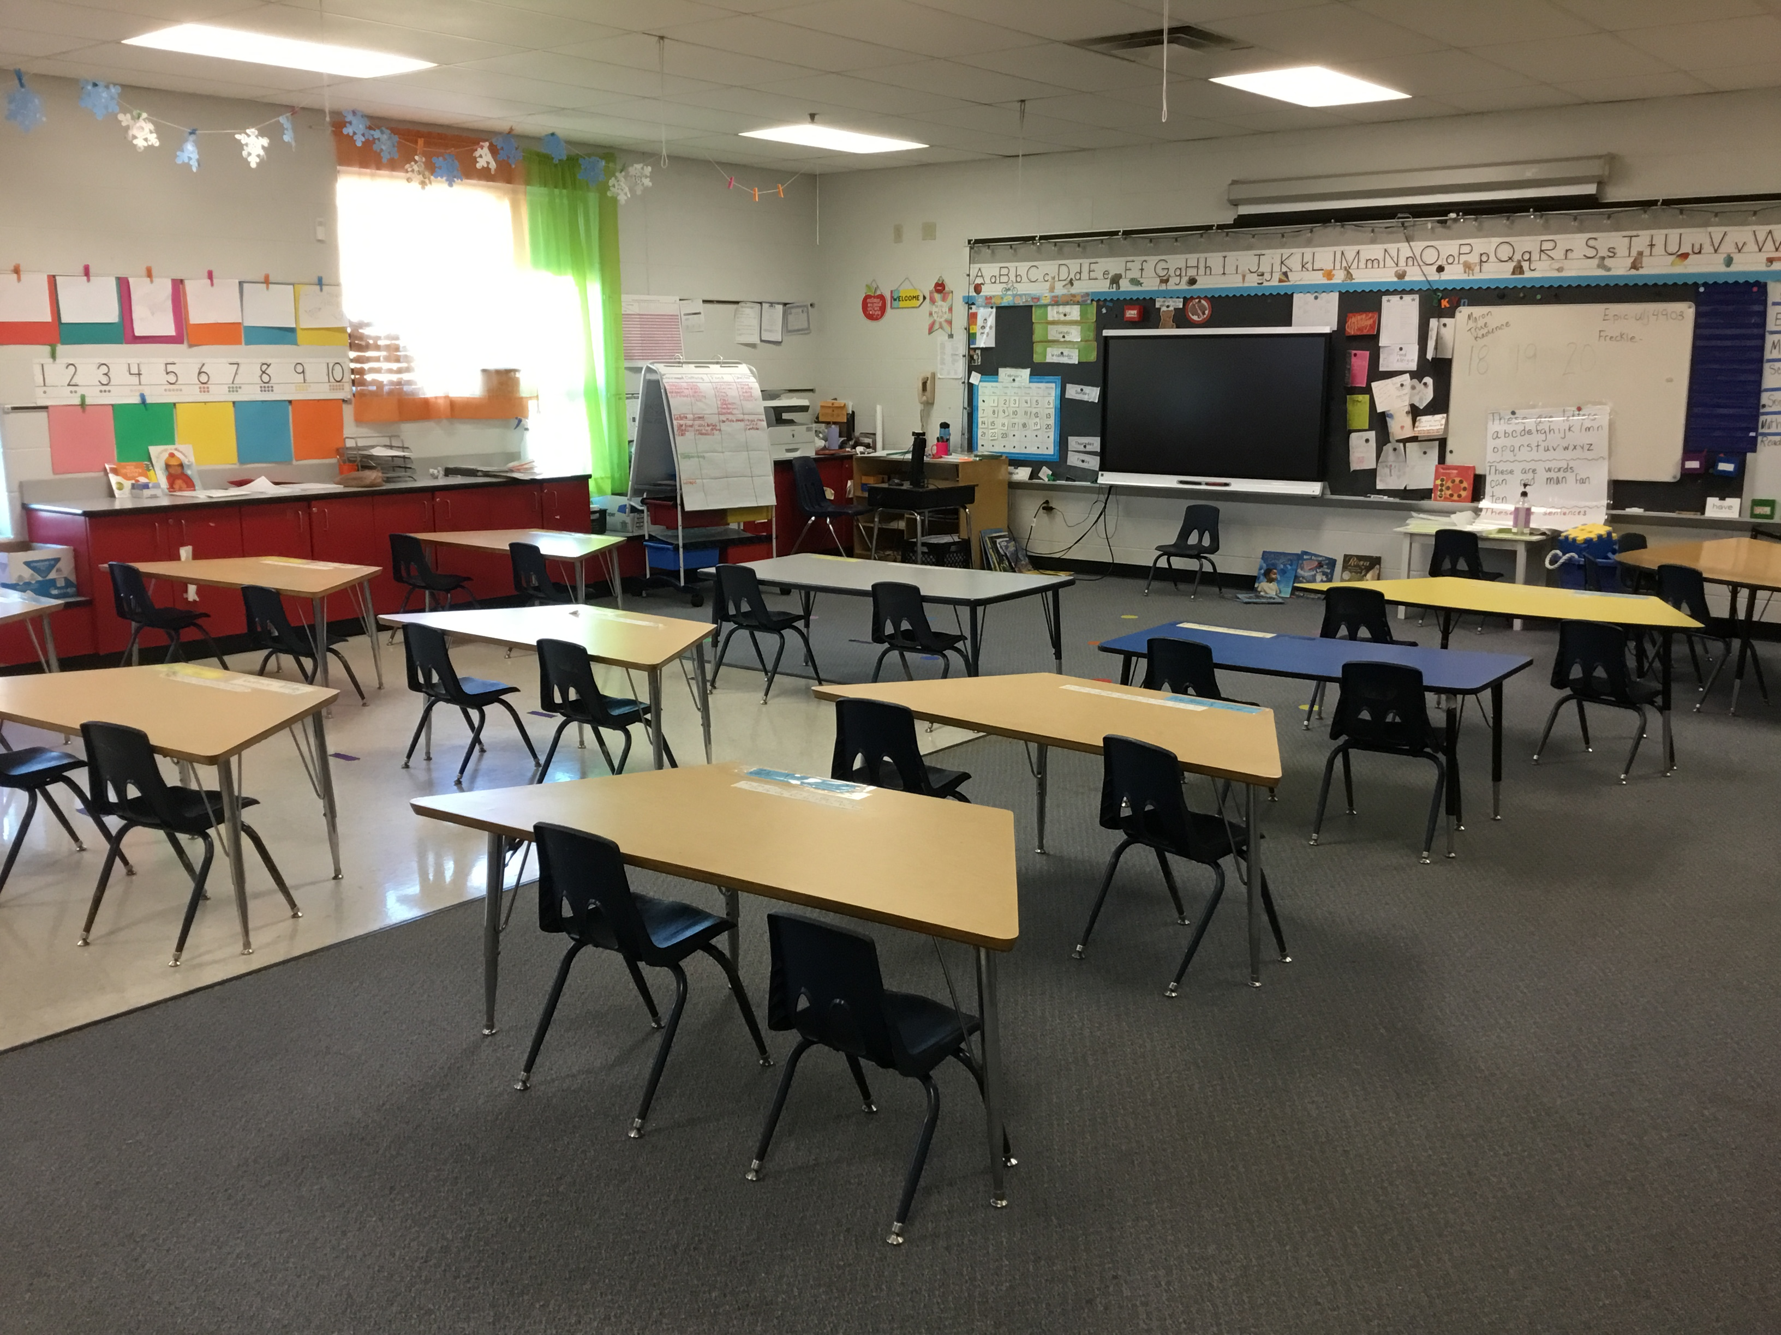
Kindergarten Hallway
Kindergarten classroom
Kindergarten

Slide 17
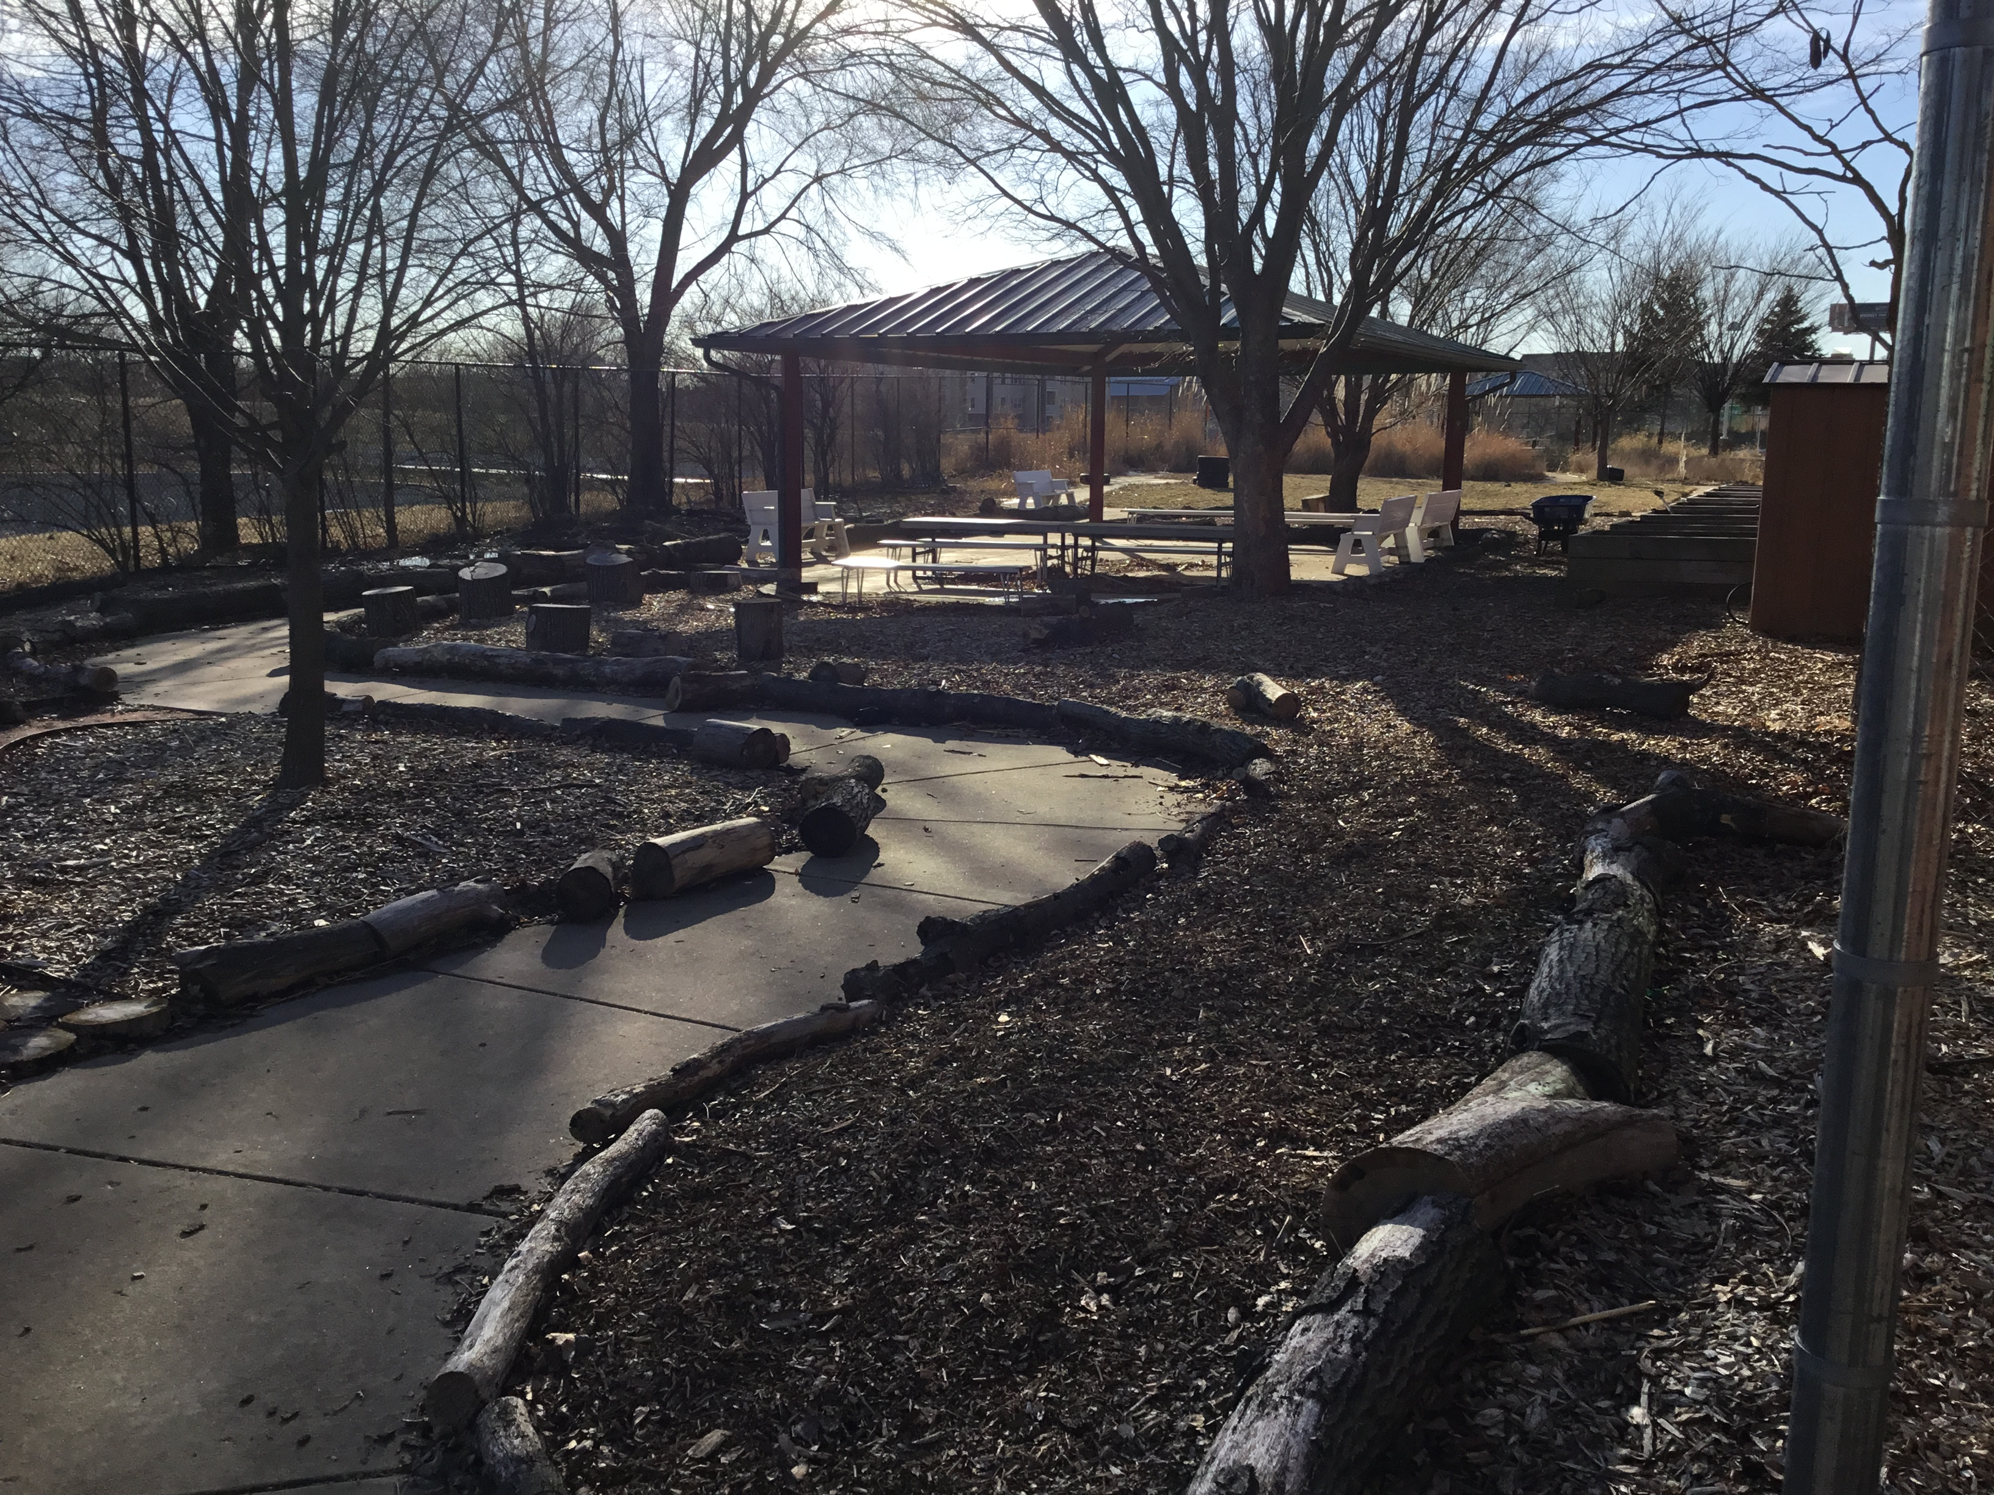
Outdoor Classroom~ A.K.A~ Incredible Garden

Slide 18
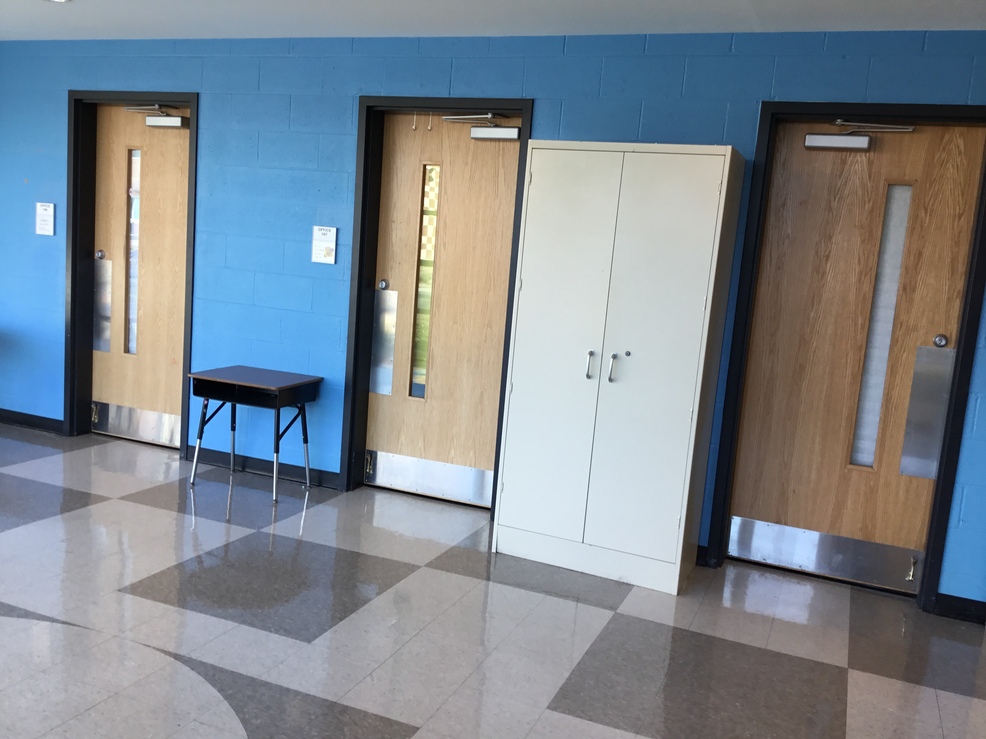
Support Services Offices

Slide 19
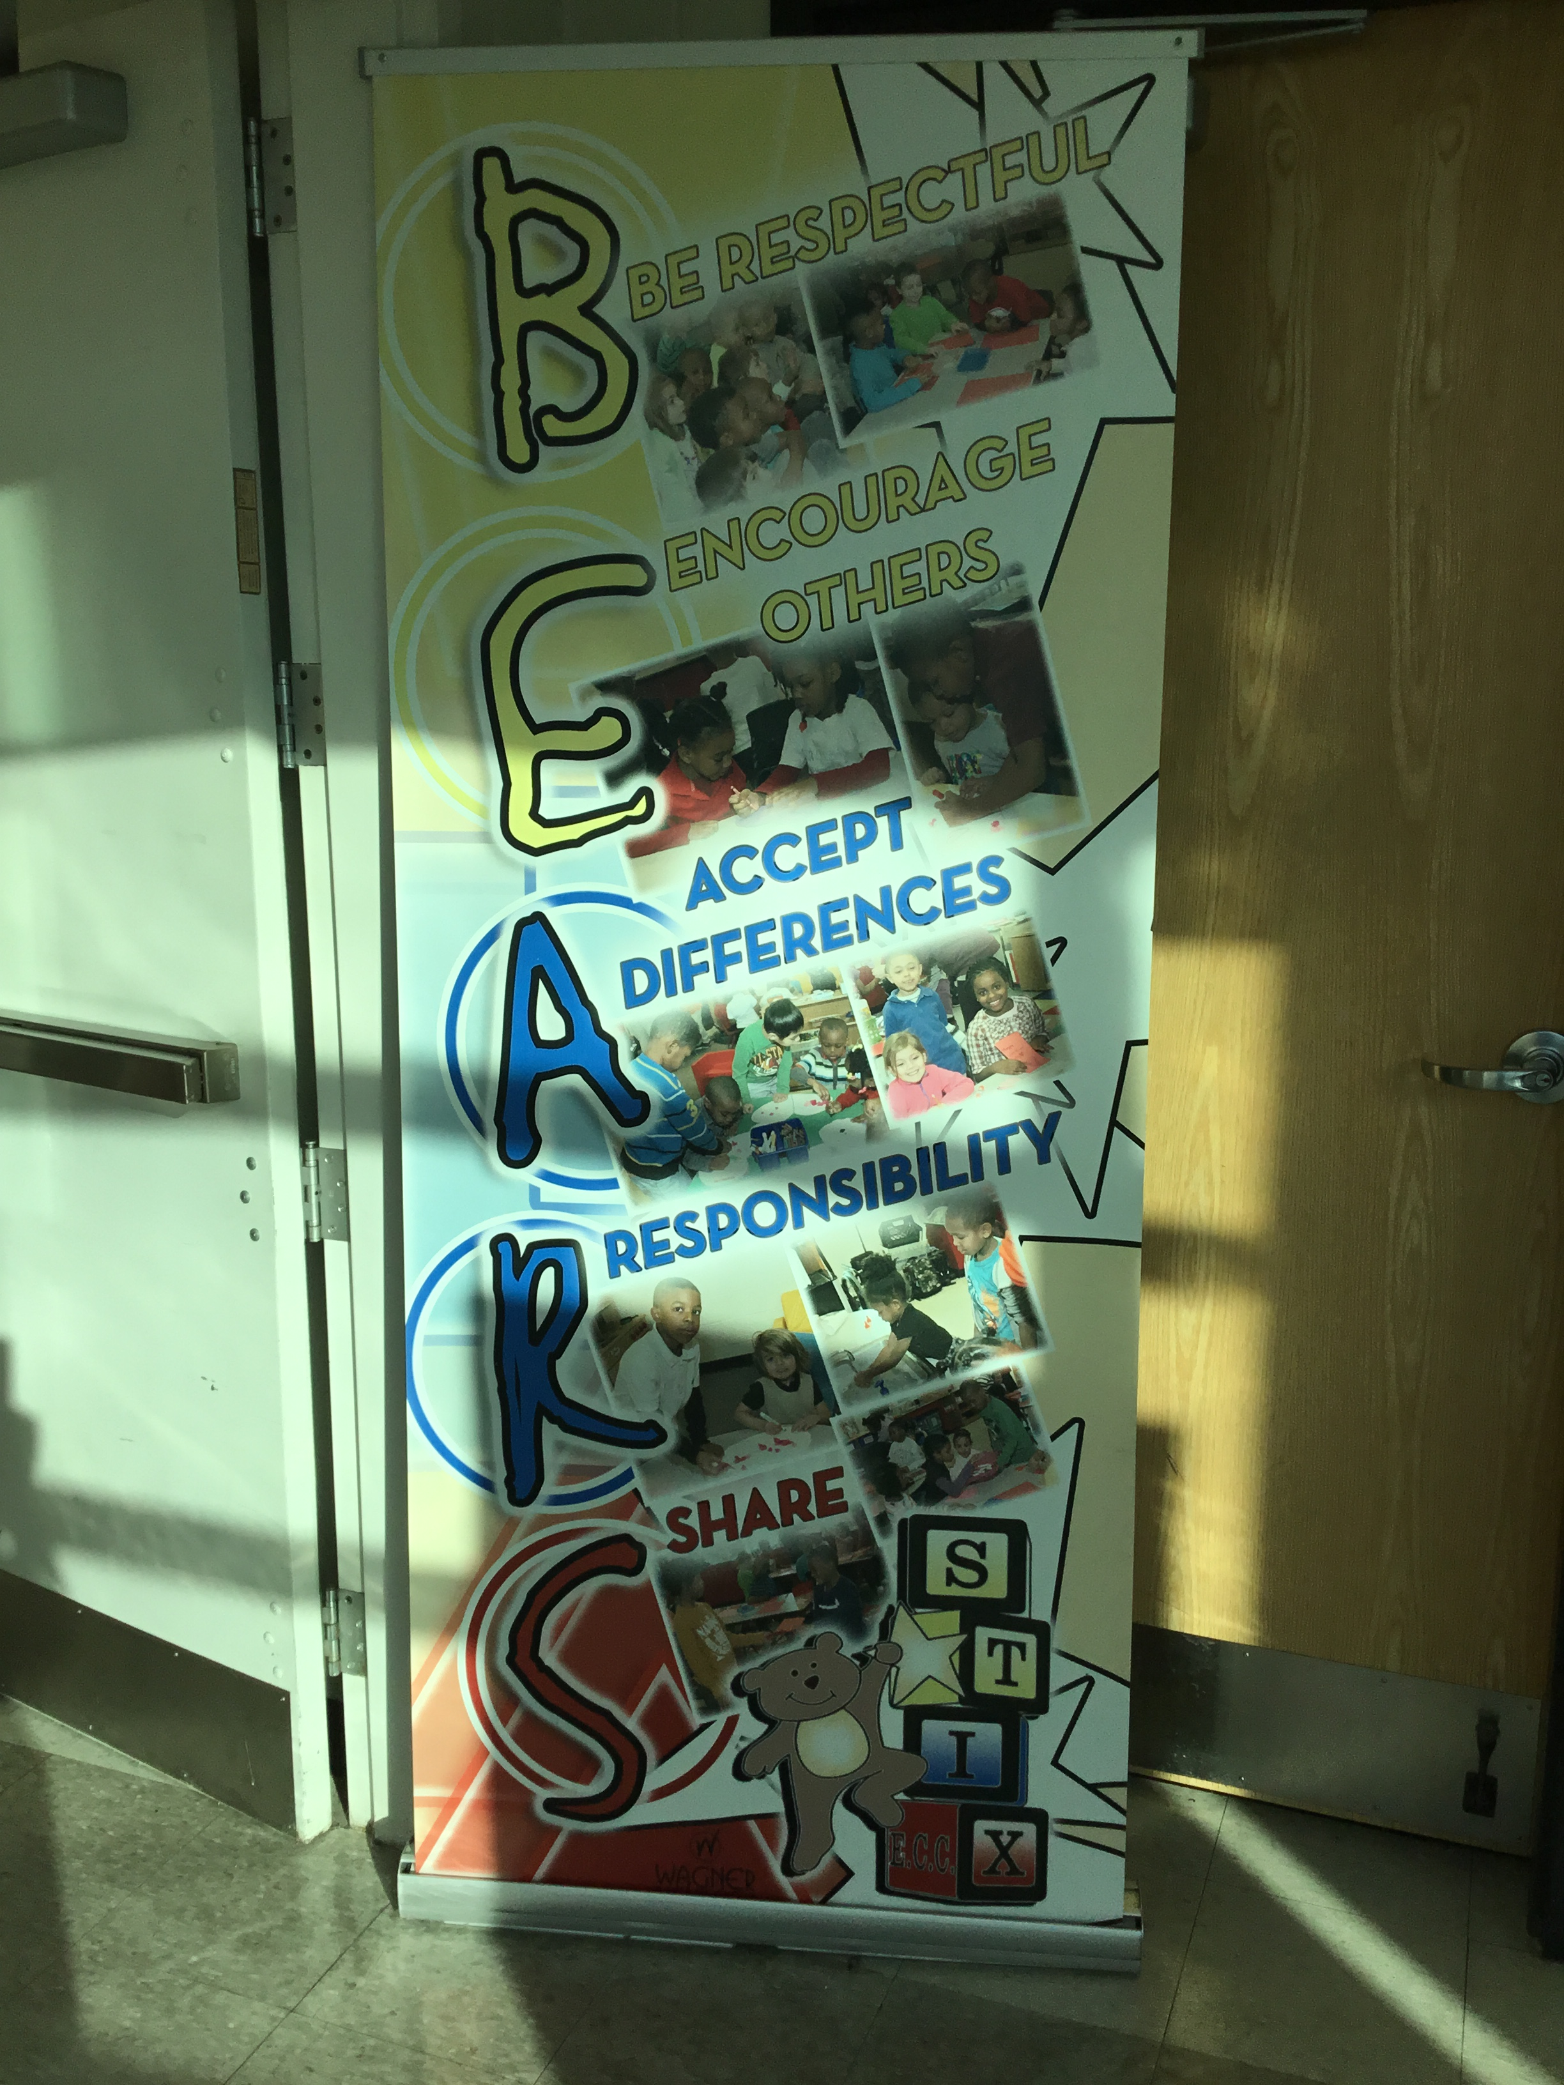
Bear Chant

Slide 20
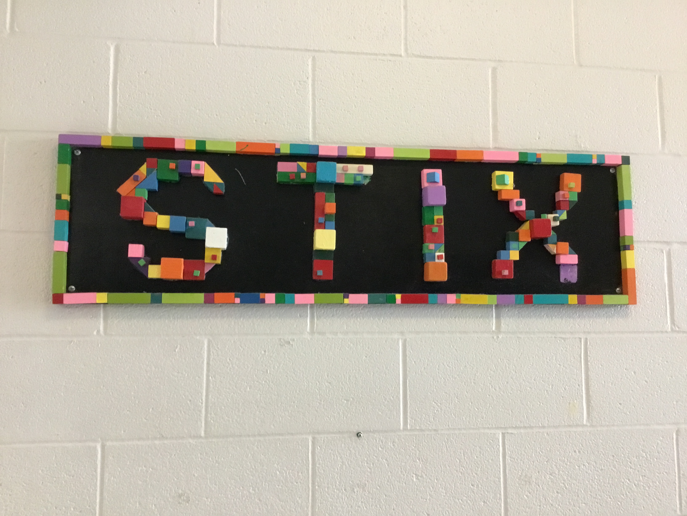
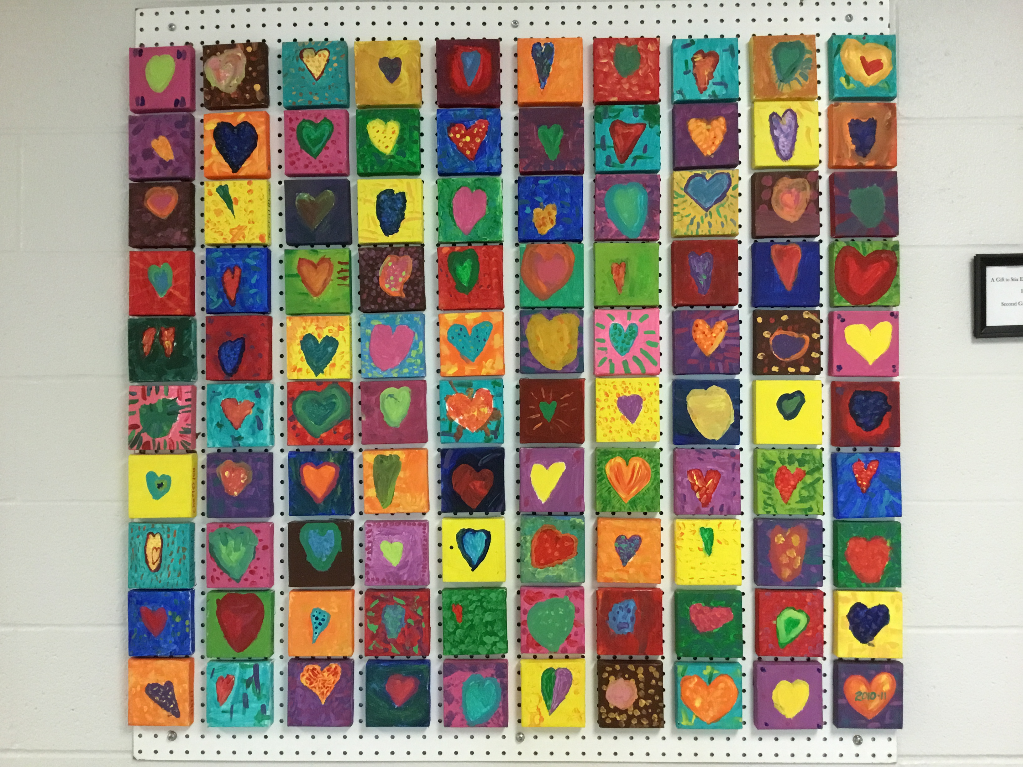
Thank You!

